Slide 1
18th Century Europe
A Century of Change

Slide 2
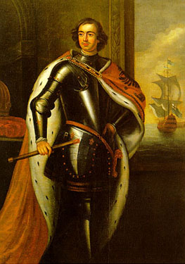
Major Events of 1700-1710
1700-1721: Great Northern War
Russia replaces Sweden as the dominant Baltic power under Peter the Great
Peter the Great vs. Charles XII
Most important battle = Battle of Poltava (Russian victory)

Slide 3
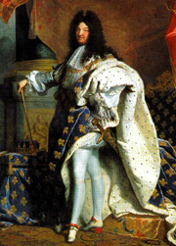
1700-1710, cont.
1701-1714: War of Spanish Succession
4th war or Louis XIV
Involved most of Europe
1700—Charles II died and bequeathed all of his possessions to Philip, duc d'Anjou —grandson of Louis XIV — who thereby became Philip V of Spain.
Leopold I (Hapsburg) (Austria) fought to protect his own dynasty's claim to the Spanish inheritance.
England, Portugal, and the Dutch Rep. entered on the Austrian side to check French expansion.
Ended with the Treaty of Utrecht (asiento -- the contract to supply the Spanish colonies with slaves, Philip, no Fr-Sp combination, Gibraltar, & the right to send one trading ship per year).

Slide 4
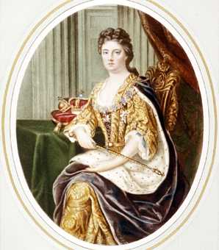
1700-1710, cont’
1703: St. Petersburg founded—part of Peter’s westernization program
1707: Act of Union
merged Scotland and England
Established “The Kingdom of Great Britain under Queen Anne
1708-1709: Famine in Prussia killed 1/3 of the population.

Slide 5
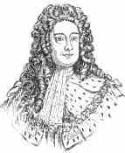
1710’s
1714: George I (House of Hanover) became King of England
1715: Louis XIV died
Jacobite Uprising in England put down.
Wanted to put James II on the throne, again.

Slide 6
1720’s
1720: South Sea Bubble collapsed
English joint-stock company formed in 1713 on speculation that the Treaty of Utrecht would open more trade to England in the “S. Seas” (really Spanish America).
Share prices hit a high of L1000 in 1720 before dropping to a low of L100 by the end of 1720, due to unexpectedly low profits
The company continued in the slave trade, selling 4800 people/year into slavery until 1763.

Slide 7
More 1720’s
1721—End of Great Northern War
Treaty of Nystad
1721—First English Prime Minister
Robert Walpole
1723—Slavery abolished in Russia
They became serfs ☹

Slide 8
1730’s
1733-38: War of Polish Succession
Stanislaw Leszcynski had been installed as king of Poland by Charles XII of Sweden during the early part of the Great N. War.
Stanislaw was ousted following Poltava by Peter the Great—replaced by Augustus II of Saxony.
After Augustus died, Stan wanted his job back.
Stan was supported by his son-in-law, Louis XV (Fr.), who hoped to renew France's traditional alliance with Poland as a way to balance Russian and Austrian power in Northern and Eastern Europe

Slide 9
War, cont.
In 1732 Empress Anna of Russia, Charles VI of Austria, and Frederick William I of Prussia decided to jointly back the candidacy of Emmanuel of Portugal for the Polish throne.
Louis XV was joined by his uncle, King Philip V of Spain, who hoped to secure territories in Italy.
The two Bourbon monarchs were also joined by Charles Emmanuel of Savoy, who hoped to secure gains from the Austrian Duchy of Milan.
The Dutch and England remained neutral

Slide 10
War Ends
Russia quickly overran Stan who fled to France.
BUT…Prussia, Austria, and France all fought on German soil and soon France took over Lorraine and Stan ruled it.
The French (and their allies), hoping for détente and good relations with the Austrians, now recognized the Pragmatic Sanction
allowed Maria Theresa to succeed her father.
This proved a hollow guarantee, however, as the French decided to intervene to partition the Habsburg Monarchy after all following Charles's death in 1740.

Slide 11
1730’s
1735-39: Russo-Turkish War
caused by intensified contradictions over the results of the War of Polish Succession
Russia ousted the Turkish ally, Stan.
caused by endless raids on Russia (current day Ukraine) by the Turkish allies, the Crimean Tatars.
The war also represented Russia's continuing struggle for the access to the Black Sea/Turkish Straits.
Russia won but settled for little territory because of an impending attack by Sweden.

Slide 12
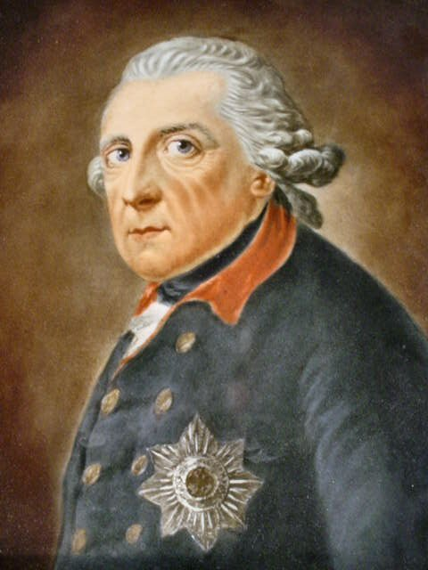
1740’s
1740: Fred the Great (Fred. II) came to power in Prussia
1740-1741: Famine in Ireland killed 10% of its population.

Slide 13
1740’s
1740-1748: War of Austrian Succession
The war began under the pretext that Maria Theresa was ineligible to succeed to the Austrian Hapsburg throne, because medieval Salic law (Frankish kingdom) precluded royal inheritance by a woman.
The war was in direct violation of the Pragmatic Sanction that MT’s dad had arranged.
***Major conflict of the war revolved around whether Prussia or Austria would control Silesia (rich in minerals).

Slide 14
War of Austrian Succession, cont.
Significant because Prussia showed up with a professional standing army.
Austria, England, and the Dutch Rep vs. Prussia, France, and Spain
N. American part of war = King George’s War
France and England also fought over India
War of Jenkin’s Ear—Spain v.England
Naval War

Slide 15
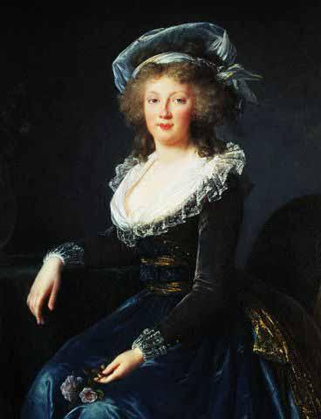
End of the War
Results:
Treaty of Aix-la Chapelle
MT got to keep the Austrian throne
Silesia went to Prussia
Temporarily bankrupted Fred’s coffers
Lots of prestige for Fred

Slide 16
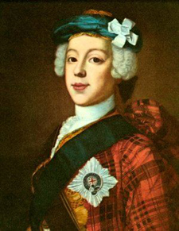
1740’s cont.
1745: Another Jacobite Rebellion
Bonnie Prince Charlie tried to take over England with the help of some Scottish clansmen and the French.
Failed

Slide 17
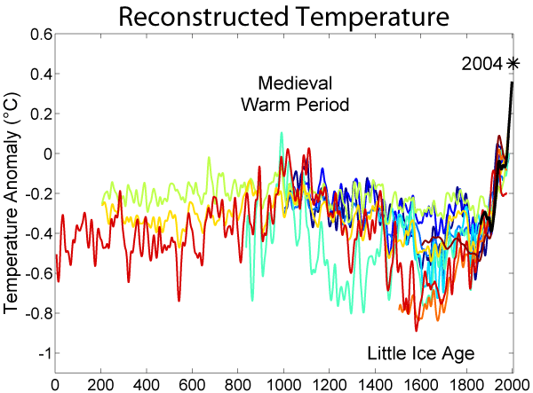
1750’s
1750: Peak of Little Ice Age brought widespread famine

Slide 18
1750’s
1756-1763: Seven Years’ War
1,400,000 deaths
***Diplomatic Revolution***
century-old enemies France, Austria and Russia formed a single alliance against Prussia.
Prussia and England (Portugal) vs. Austria and France (Russia, Sweden, Spain, & Saxony)
French and Indian War in N. America (1754-1763)

Slide 19
Battle of Kunersdorf

Slide 20
7 Years’ War
Began with Frederick the Great’s (Pr.) invasion of Saxony.
The British had the most formidable navy in Europe while Prussia had the most formidable land force on continental Europe.
This allowed Great Britain to focus its soldiers towards its colonies.
The Austrian army had undergone an overhaul according to the Prussian system.
Maria Theresa pressed relentlessly for reform.
Her interest in the welfare of the soldiers had gained her their undivided respect.

Slide 21
Battle of Plassey

Slide 22
Battle of Plassey
June 1757—part of the Seven Years’ War
English victory over the Nawab of Bengal and his French allies established the dominance of the British East India Company in India
one of the pivotal battles leading to the eventual formation of the British Empire in India.

Slide 23
End of the War
1763: Treaty of Paris--involved a complex series of land exchanges
France ceded Louisiana territory to Spain
France ceded the rest of New France to England.
France was given the choice of keeping either New France or its Caribbean island colony Guadeloupe, and chose the latter to retain one of its sources of sugar.

Slide 24
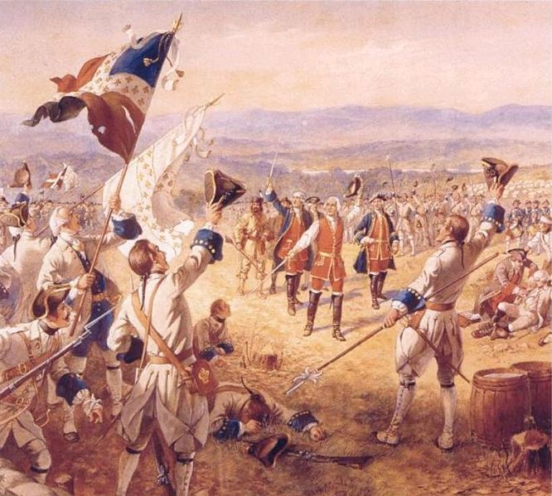
The War Ends
The war ended France's position as a major colonial power in the Americas and its position as the leading power in Europe
England became the dominant power in Europe and N. America.

Slide 25
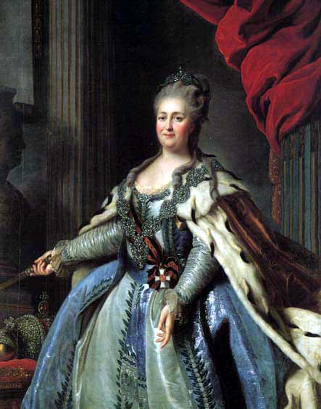
1760’s
1762: Catherine the Great began to rule Russia (1762-1796)
1763: Seven Years’ War Ended

Slide 26
1770’s
1770-1771: Czech “Great Famine”
The cause of the Great Famine was a disease of grain and heavy rains.
The Great Famine:
killed twelve percent of the Czech lands’ population, approx. 500,000 inhabitants
radicalized rural areas, leading to peasant uprisings.
This famine ended when Czech lands imported potatoes, increasing potato production in the future.

Slide 27
1770’s
1772, 1793, & 1795: Three Partitions of Poland
Divided between Prussia, Austria, and Russia
After 1795, Poland disappeared off of the map until if was reestablished by the Versailles treaty of 1919.

Slide 28
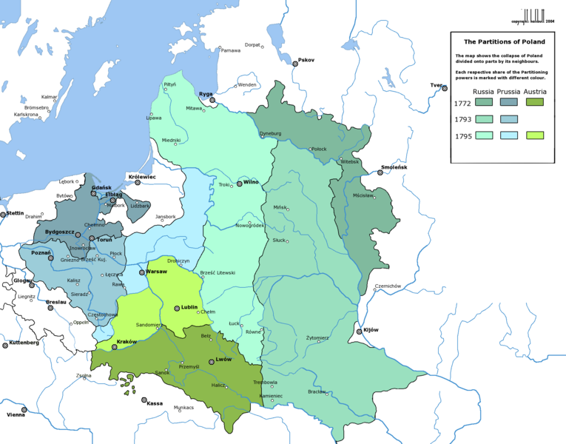
Three Partitions of Poland

Slide 29
1770’s
1773-1775: Pugachev’s Rebellion--largest peasant revolt in Russia’s history
As the Russian monarchy contributed to the degradation of the serfs, peasant anger ran high.
Peter the Great ceded entire villages to favored nobles, while Catherine the Great confirmed the authority of the nobles over the serfs in return for the nobles' political cooperation.
The unrest intensified as the 18th century wore on, with more than fifty peasant revolts occurring between 1762 and 1769.
These culminated in Pugachev's Rebellion, when, between 1773 and 1775, Emelyan Pugachev rallied the peasants and Cossacks and promised the serfs land of their own and freedom from their lords.

Slide 30
Pugachev’s Rebellion
Pugachev established an army of his own
Pugachev had defected as an ensign from Catherine's army.
He built up his own War College and a fairly sophisticated intelligence network of messengers and spies.
Even though Pugachev was illiterate, he recruited the help of local priests to write and disseminate his "royal decrees" to villages where they were read to the masses by priests.
In these documents, he begged the masses to serve him faithfully. He promised to grant to those who followed his service land, salt, grain, and lowered taxes, and threatened punishment and death to those who didn't

Slide 31
Pugachev’s Rebellion
In 1773, his army attacked Samara and Kazan, by which time his captured territory stretched from the Volga to the Ural mountains.
Though fairly well-organized for a revolt at the time, Pugachev's main advantage early on was the lack of seriousness about Pugachev's rebellion.
Catherine regarded the troublesome Cossack as a joke and put a small bounty of about 500 rubles on his head.
But by 1774, the threat was more seriously addressed; by November the bounty was over 28,000 rubles.
By late 1774 the tide was turning.
By early September, the rebellion was mostly crushed. Emelyan Pugachev was betrayed by his own Cossacks when he tried to flee in mid-September 1774, was caught and executed in Jan. 1775, in Moscow.

Slide 32
1770’s
1775-1783: American Revolution
Challenged the principles of colonialism and mercantilism in Europe.
1776: Adam Smith published “The Wealth of Nations”
“invisible hand metaphor”
Father of capitalism

Slide 33
1780’s
Enlightenment continued
French economic problems threatened to bankrupt the nation and stirred up unrest.
1789: French Revolution broke out.

Slide 34
1790’s
1792-1815: Wars of the French Revolution and Napoleonic Wars
Quadruple Alliance formed against France
England, Prussia, Russia, Austria
1798: Irish Rebellion against the British
1799: Napoleonic Coup—Nap became First Consul and essentially a dictator.

