Slide 1
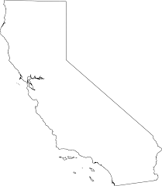
Museums in California
Anna Magdaleno
Per 2

Slide 2
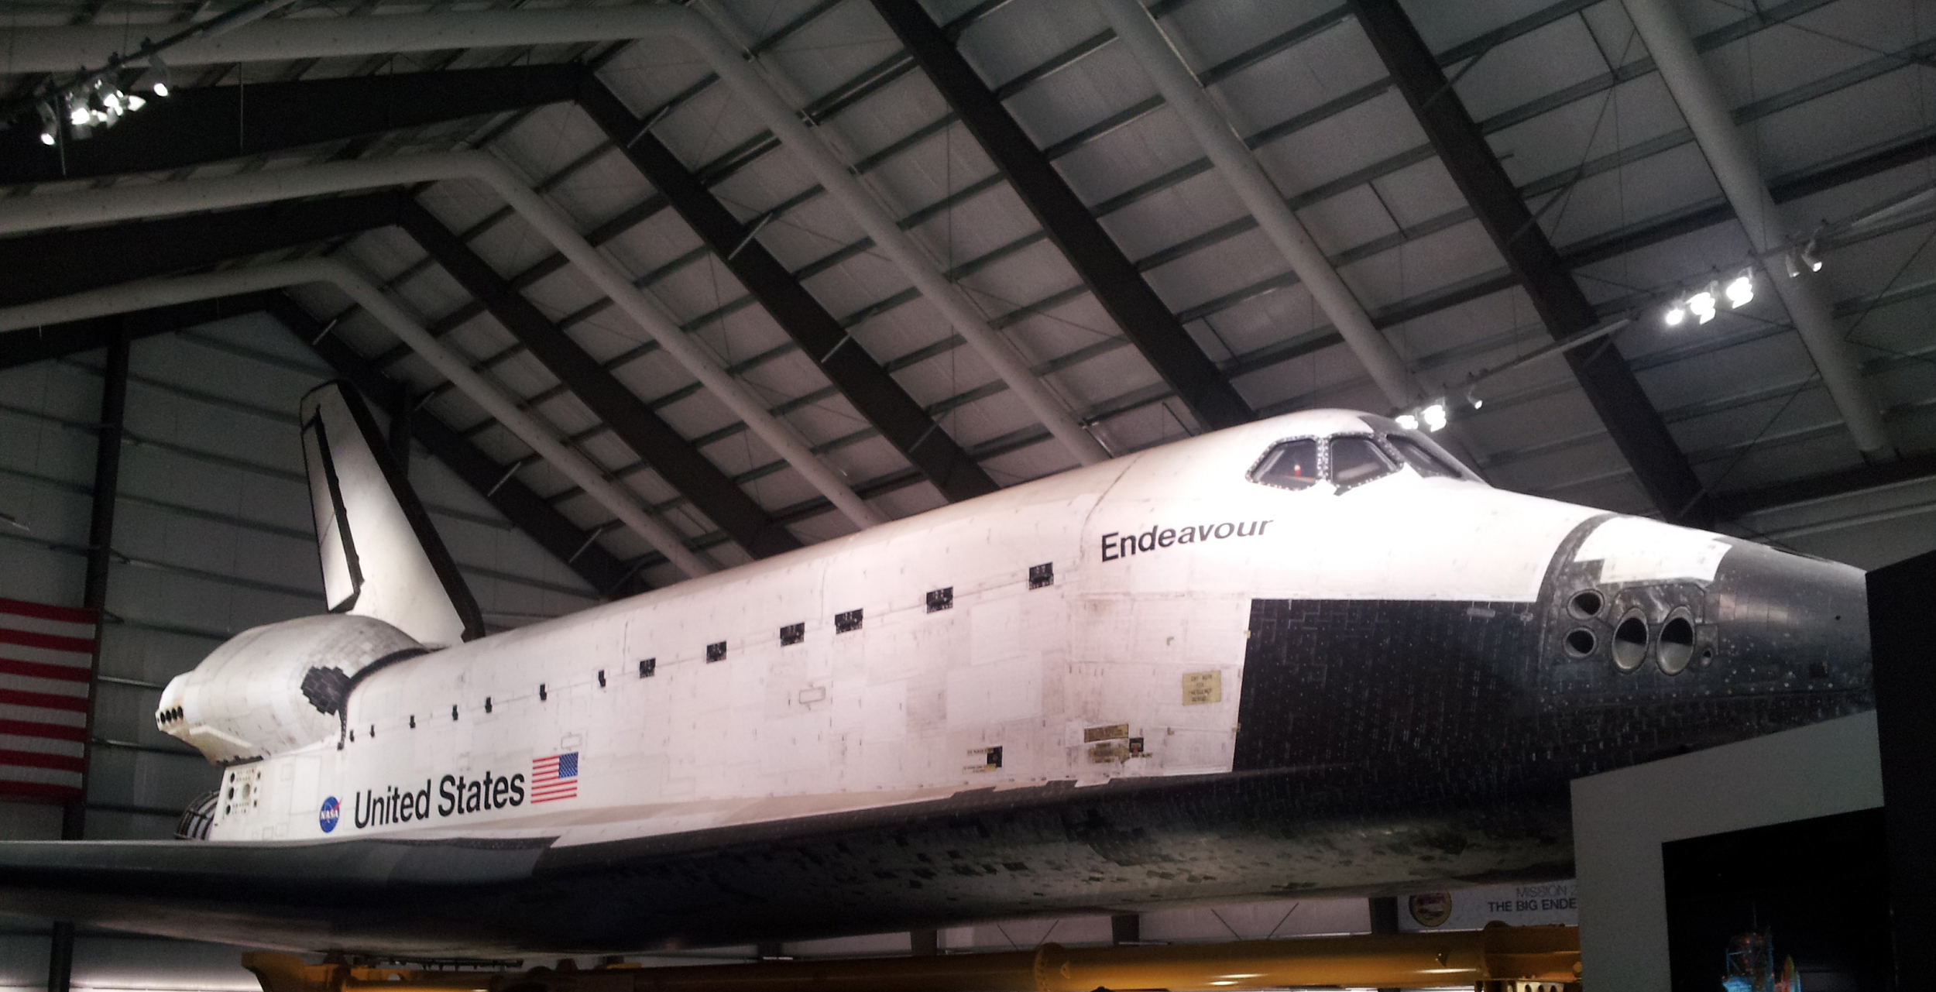
California Science Center
Free general admission, open daily
Science exhibits (World of Life, Creative World, Ecosystems, Space Shuttle Endeavour)
On-site science center school, Amgen center
https://californiasciencecenter.org/
700 Exposition Park Drive Los Angeles, CA 90037

Slide 3
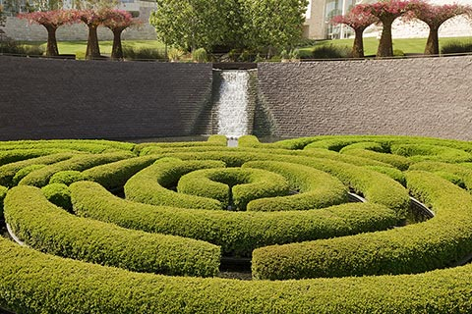
The Getty Center
Collection of famous artworks from Medieval to present, architecture, gardens
Open Tuesday- Sunday; 10am to 5:30pm; parking $15
http://www.getty.edu/visit/center/
1200 Getty Center Dr, Los Angeles, CA 90049-1657

Slide 4
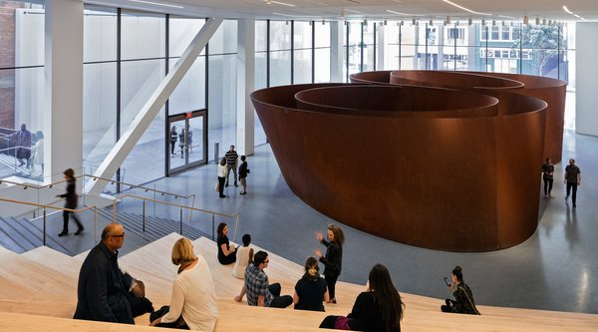
San Francisco Museum of Modern Art (SFMOMA)
Paintings, sculptures and special exhibits (René Magritte)
Open Friday–Tuesday, 10 a.m.–5 p.m., and until 9 p.m. Thursday. Closed Wednesday. Tickets $25; Members visit free
https://www.sfmoma.org/
151 Third Street San Francisco, CA 94103

Slide 5
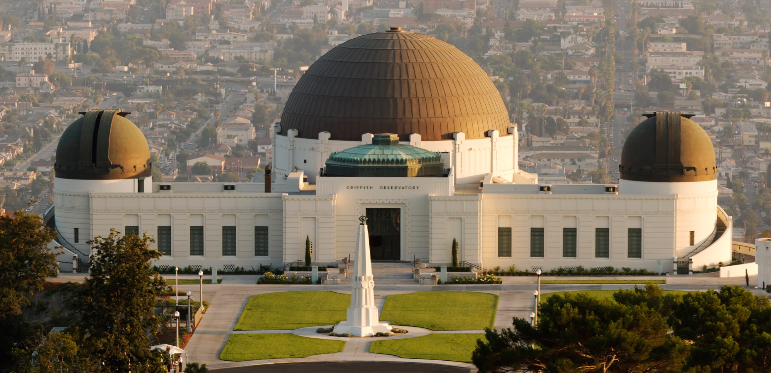
Griffith Observatory
Planetarium, exhibits, public telescopes
Free admission, open daily
http://www.griffithobservatory.org/
2800 E. Observatory Rd., Los Angeles, CA 90027-1299

Slide 6
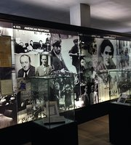
Los Angeles Museum of the Holocaust (LAMOTH)
Commemoration of those who were victims and education for students on the holocaust
Free admission; open daily 10am to 5pm
http://www.lamoth.org/
100 The Grove Dr, Los Angeles, CA 90036-6200

Slide 7
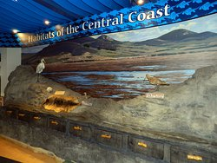
Museum of Natural History
Interactive learning with the tides, geology and environment
Open daily, 10am to 5pm; admission $2
http://www.morrobaymuseum.org/
Morro Bay State Park Museum of Natural History Morro Bay, CA 93442

Slide 8
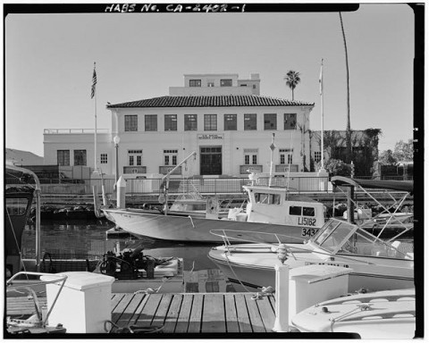
Santa Barbara Maritime Museum
Celebrating and exploring the ocean, Navy pier, Navy reserve
Open daily, $8 admission
https://www.sbmm.org/
13 Harbor Way Ste 190, at the Santa Barbara Harbor, Santa Barbara, CA 93109-2344

Slide 9
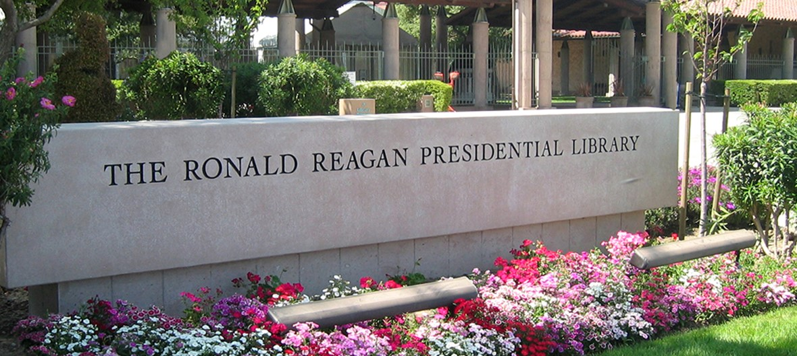
Ronald Reagan Presidential Library and Museum
Air force one, Berlin wall, National archives
Open daily, 10am to 5pm; admission $25
https://www.reaganfoundation.org/
40 Presidential Dr, Simi Valley, CA 93065-0600

Slide 10
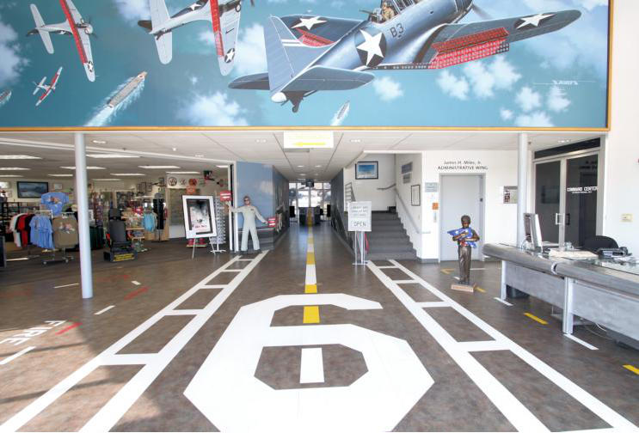
Palm Springs Air Museum
View legendary planes from WWII, Vietnam and Korea
Open daily, 10am to 5pm; admission $17
https://palmspringsairmuseum.org/
745 North Gene Autry Trail Palm Springs, California 92262

Slide 11
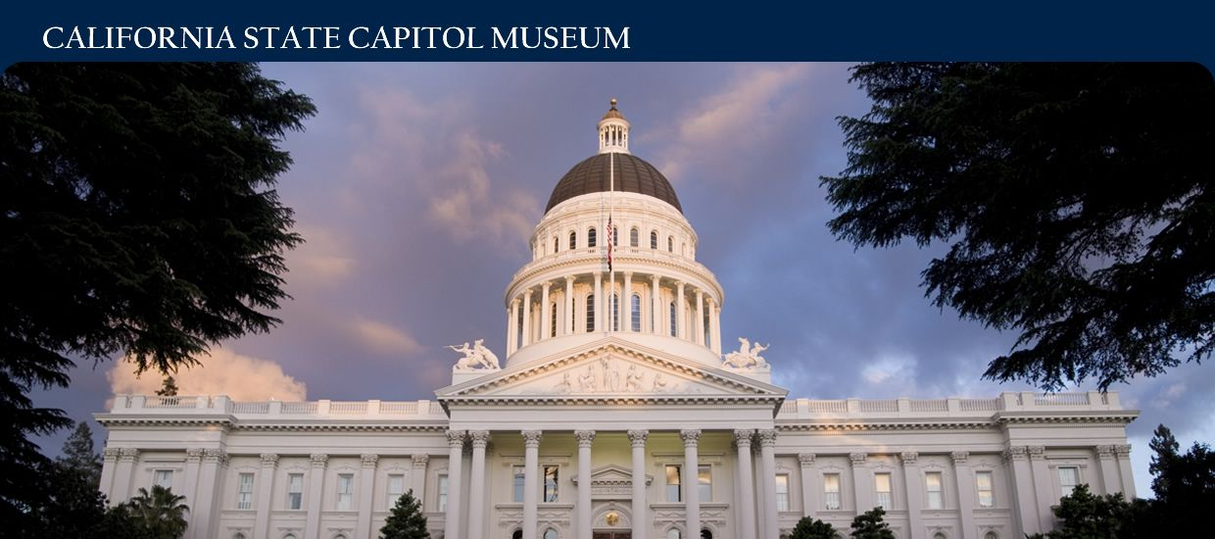
California State Capitol Museum
California legislature
Open daily; free admission
http://capitolmuseum.ca.gov/
1315 10th St, Room B-27, Sacramento, CA 95814-4905

Slide 12
La Brea Tar Pits and Museum
Fossil lab, Ice Age excavation, Atrium, Lake pit
$25 admission, $15 parking; open daily 9:30am to 5pm
http://www.tarpits.org/
5801 Wilshire Blvd, Los Angeles, CA 90036-4539

Slide 13
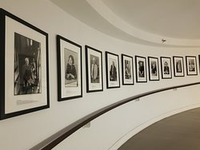
Museum of Tolerance
Human rights education center, promotes tolerance and understanding prejudice and discrimination.
Open daily except saturday, 10 am to 5pm; $15.50 admission
http://www.museumoftolerance.com/site/c.tmL6KfNVLtH/b.9052747/k.BEE4/Home.htm
Simon Wiesenthal Plaza, 9786 W. Pico Blvd, Los Angeles, CA 90035

Slide 14
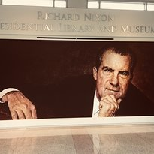
Richard Nixon Presidential Library and Museum
Exhibits, films, multimedia, gardens
Admission $16; open daily, 10am to 5pm
https://www.nixonfoundation.org/
18001 Yorba Linda Blvd, Yorba Linda, CA 92886-3903

Slide 15
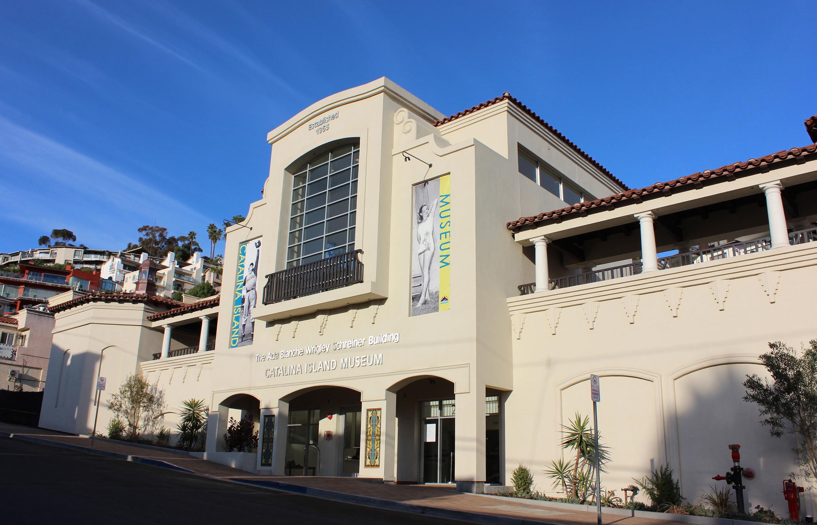
Catalina Island Museum
Channel island history, music, guest speakers
$17 admission; open daily, 10am to 5pm
https://www.catalinamuseum.org/
217 Metropole Avenue, Avalon, Catalina Island, CA 90704

Slide 16
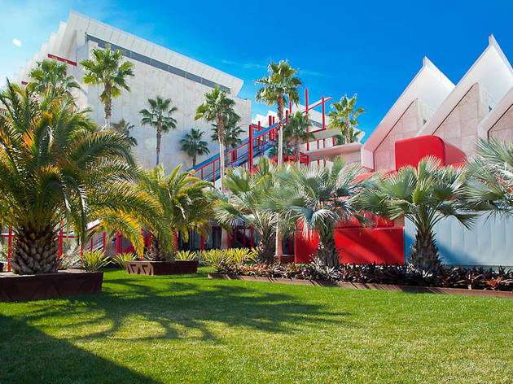
Los Angeles County Museum of Art (LACMA)
Galleries and exhibitions of modern and historical art pieces
Open daily except Wednesday; $25 admission
http://www.lacma.org/plan-your-visit
5905 Wilshire Blvd, Los Angeles, CA 90036-4597

