Slide 1
Absolutism in
Austria, Prussia & Russia

Slide 2
The Habsburgs
&
Austria

Slide 3
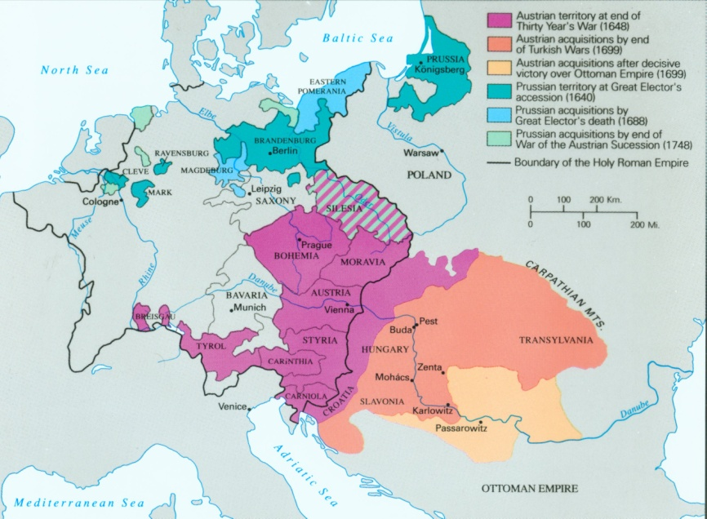
The Growth of Austria and Prussia to 1748

Slide 4
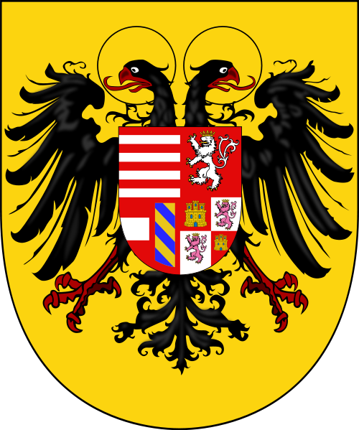
Habsburg Family Crest

Slide 5
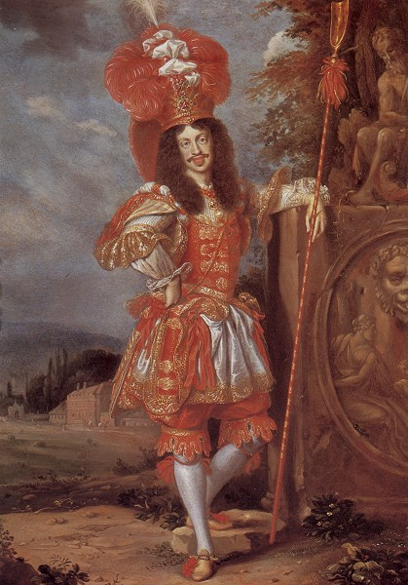
Leopold I
Holy Roman Emperor
(r.1657-1705)

Slide 6
Austria turned inward and eastward after the Thirty Years’ War
Serfdom increased, Protestantism was wiped out, and absolutism was achieved
The Habsburgs crushed the Protestant nobility, land was given to the Catholic soldiers, binding local peasants to them

Slide 7
Siege of Vienna (1683) – Habsburg, with Polish support, defeated the Ottoman Turks and began increasing their territory
In 1686, Austria captured the capital of Hungary. In 1699, acquired most of Hungarian land. n turned toward Hungary for land.
Supported the English against the French in the War of Spanish Succession. (against Bourbons taking over Habsburgs in Spain)

Slide 8
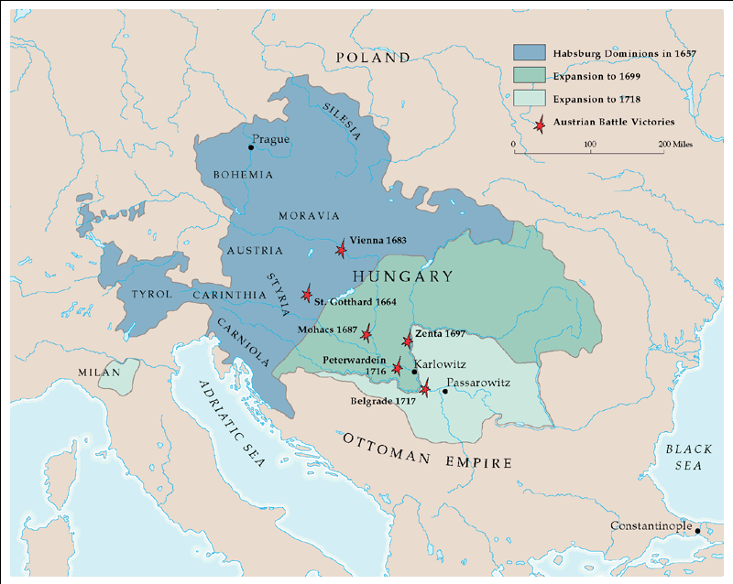
Austrian Empire: 1657-1718

Slide 9
Habsburg possessions consisted of Austria, Bohemia, and Hungary
Pragmatic Sanction stated that the possessions should never be divided

Slide 10
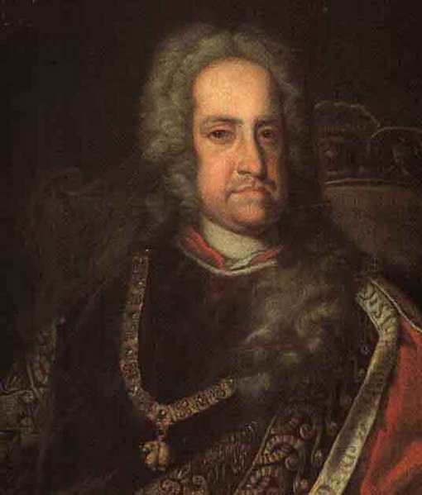
Charles VI (r. 1711-1740)
Created the Pragmatic Sanction to ensure his daughter, Maria Theresa, would inherit Habsburg lands and become queen

Slide 11
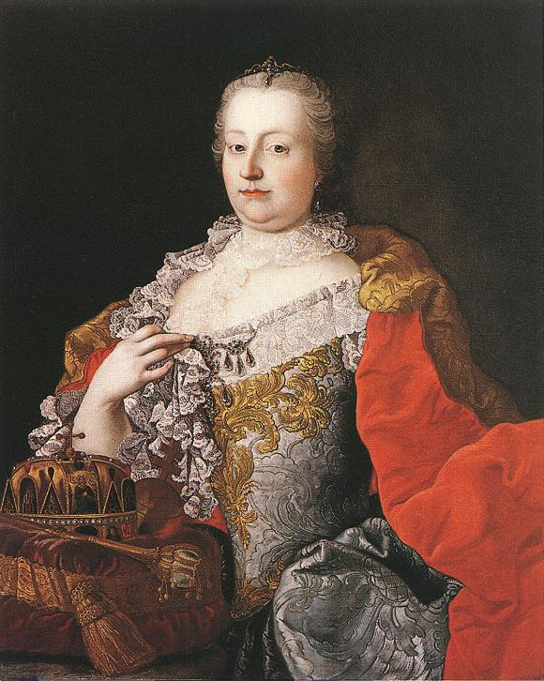
Maria Theresa
(r. 1740-1780)
Went to war with Prussia in the War of Austrian Succession

Slide 12
Serfdom in Eastern Europe to 1740
Hereditary serfdom took place in Poland, Prussia and Russia
Peasants were bound to their lords and the land from one generation to the next

Slide 13
Serfdom increased because of political not economic reasons
Westerners began to regard eastern Europe as culturally and morally inferior
Peasants and middle class had no chance for advancement
Landlords controlled the courts (justice system)
Overall the peasants had less power in Eastern Europe than in Western Europe

Slide 14
The Hohenzollerns
&
Brandenburg-Prussia

Slide 15
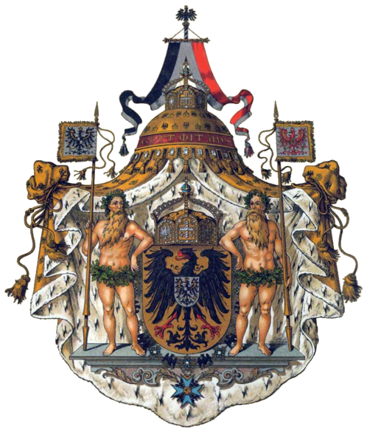
Hohenzollern Family Crest

Slide 16
The Hohenzollern family ruled the electorate of Brandenburg and Prussia within the Holy Roman Empire
The Thirty Years’ War weakened the HRE and allowed the Hohenzollerns to consolidate their absolutist rule
Frederick William (the Great Elector) built a strong Prussian army and infused military values into Prussian society

Slide 17
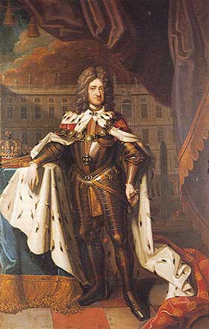
King Frederick of Prussia
(r.1701-1713)
Separated Prussia from Poland.
Supported the Habsburgs during the War of Spanish Succession
Became “King in Prussia”

Slide 18
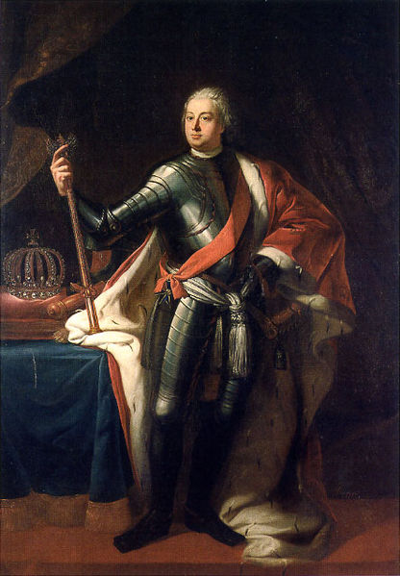
King Frederick William I
(r.1713-1740)
“The Soldier-King”

Slide 19
Frederick William I:
Most talented reformer, established Prussian absolutism
Infused strict military values into the whole society
Loved tall soldiers
Created a centralized bureaucracy, Prussia almost always at peace

Slide 20
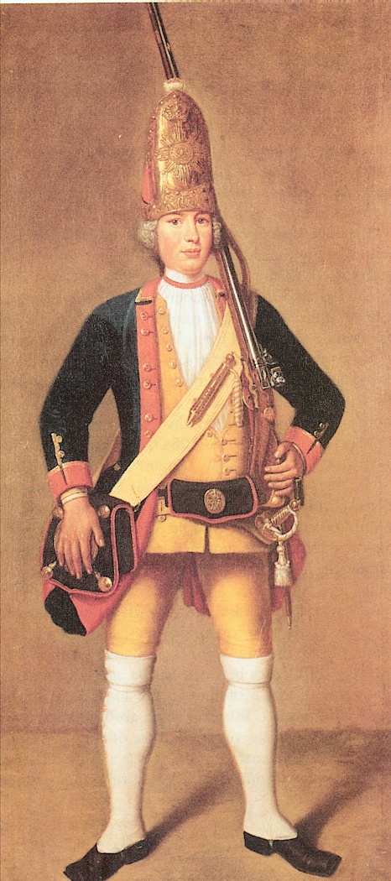
Frederick William I encouraged Prussian militarism and created the best army in Europe
The Junkers, noble landowners, became the military elite and Prussia a militarist state

Slide 21
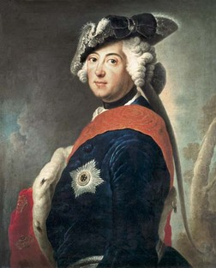
Frederick II (the Great)
(r.1740-1786)
Invaded Austria in the War of Austrian Succession and acquired the region of Silesia from the Habsburgs

Slide 22
The War of the
Austrian Succession
1741 - 1748

Slide 23
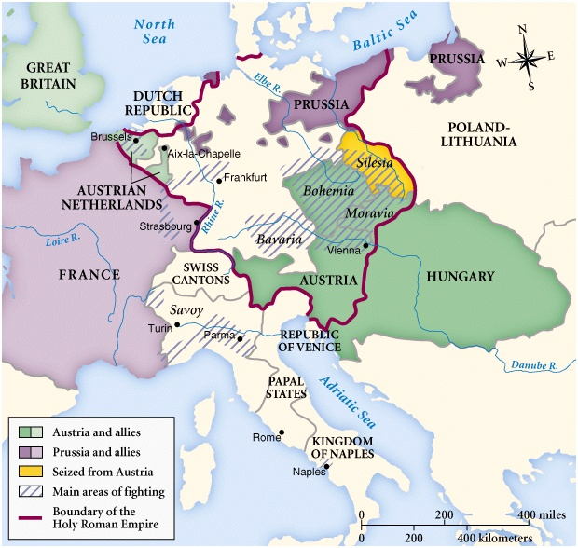
War of the Austrian Succession 1740-1748
Austria loses Silesia to Prussia

Slide 24
Russia
Рοссий

Slide 25
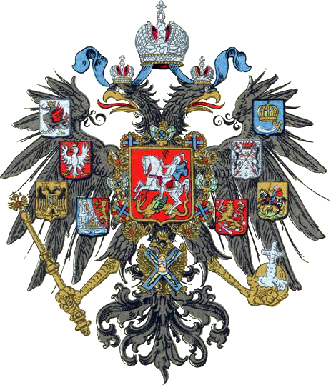
Romanov Family Crest

Slide 26
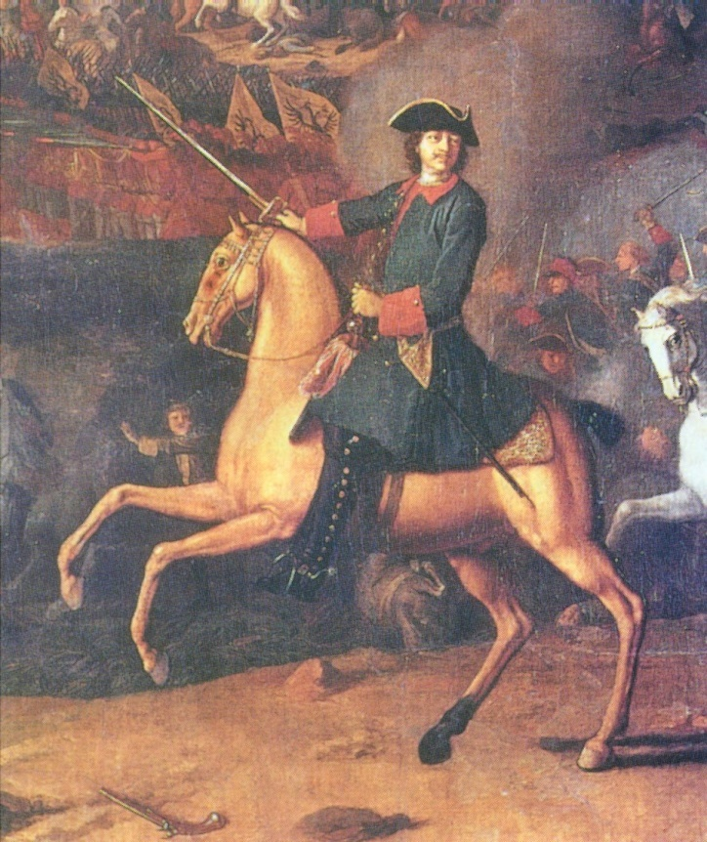
Michael Romanov was elected tsar by the boyars-Russian nobility in 1613
Romanovs brought abut the total enserfment of the people, while the military obligations on the nobility were relaxed
Peter the Great emerged as Tsar of Russia

Slide 27
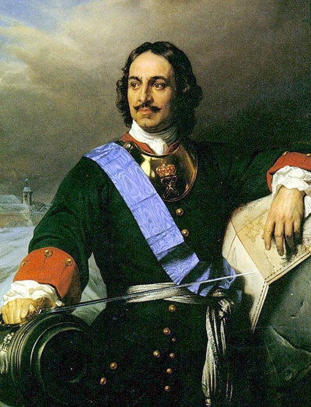
Peter the Great (1682-1725)
Peter the Great was committed to a policy of westernization in Russia. However, persuading Russians to change their way of life proved difficult. To impose his will, Peter became the most autocratic of Europe’s absolute monarchs.

Slide 28
Peter the Great
During his reign he:
forced the boyars, or landowning nobles, to serve the state or army for life.
imported western technology and culture and hired Western advisors.
insisted that the boyars shave their beards and wear western-style clothing.

Slide 29
Peter the Great
used autocratic methods to push through social and economic reforms.
brought all Russian institutions under his control.
imposed policies which caused the spread of serfdom.

Slide 30
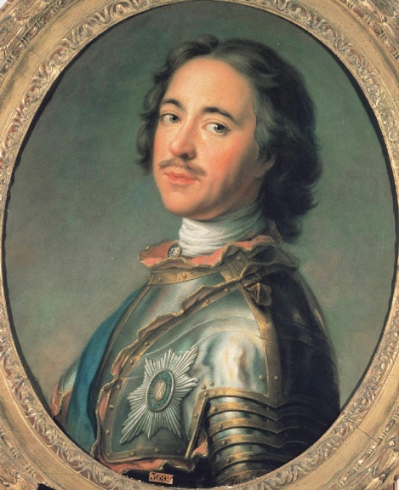
Russian peasant life became extremely difficult
People were taxed heavily
Serfs were arbitrarily assigned to work in factories and mines

Slide 31
Peter Shaving the Boyar’s Beard

Slide 32
Expansion Under Peter
Peter created the largest standing army in Europe and set out to extend Russian borders to the west and south.
He unsuccessfully fought the Ottomans in an attempt to gain a warm-water port for Russia in the Black Sea.

Slide 33
Expansion Under Peter
Made compulsory education away from home for higher classes mandatory (5 years).
Controlled the Orthodox Church.

Slide 34
Expansion Under Peter
Peter engaged in a long war with Sweden, and eventually won land along the Baltic Sea. On that land, Peter built a magnificent new capital city, St. Petersburg.
He hired a navigator to explore what became known as the Bering Strait between Siberia and Alaska.

Slide 35
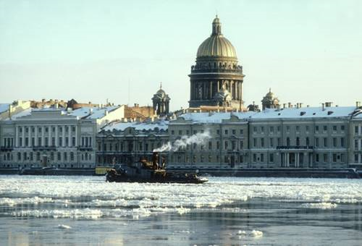
Expansion Under Peter

Slide 36
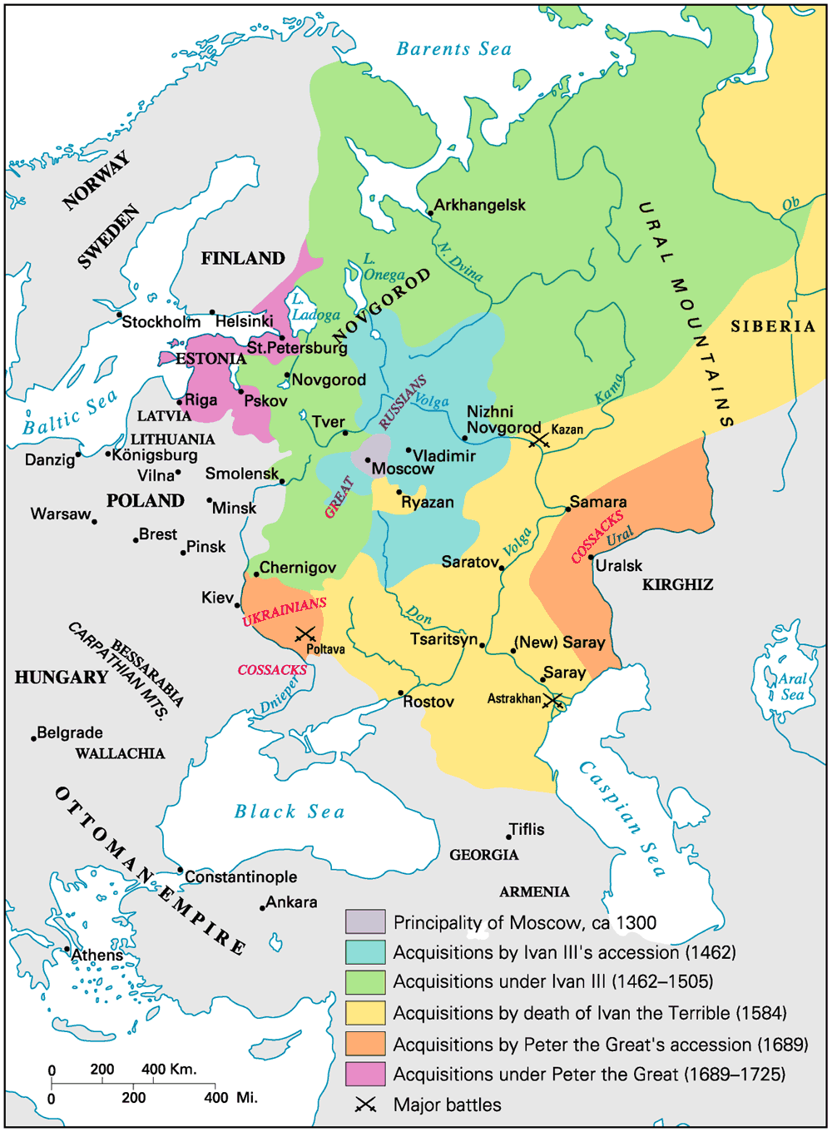
The Expansion of Russia to 1725

