Slide 1
Absolutism
in
Central Europe
Susan M. Pojer Horace Greeley HS Chappaqua, NY

Slide 2
The Habsburgs
& the
Holy Roman Empire

Slide 3
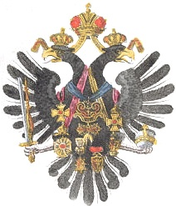
Habsburg Family Crest

Slide 4
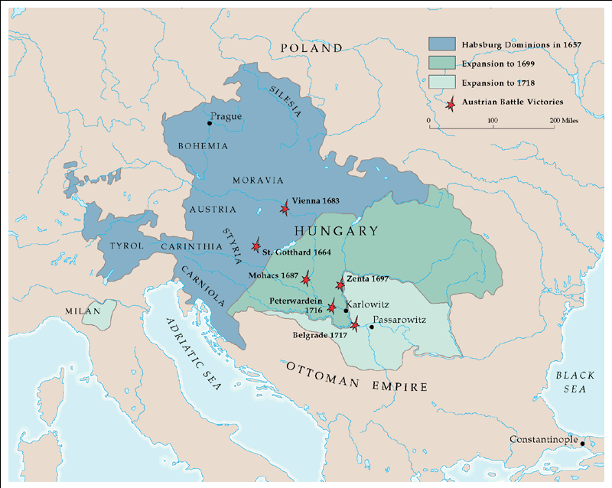
Austrian Empire: 1657-1718

Slide 5
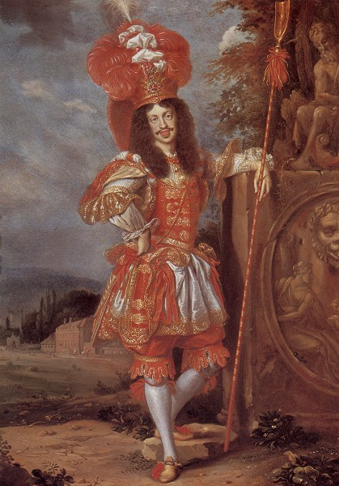
Leopold I
Holy Roman Emperor
(r. 1658-1705)

Slide 6
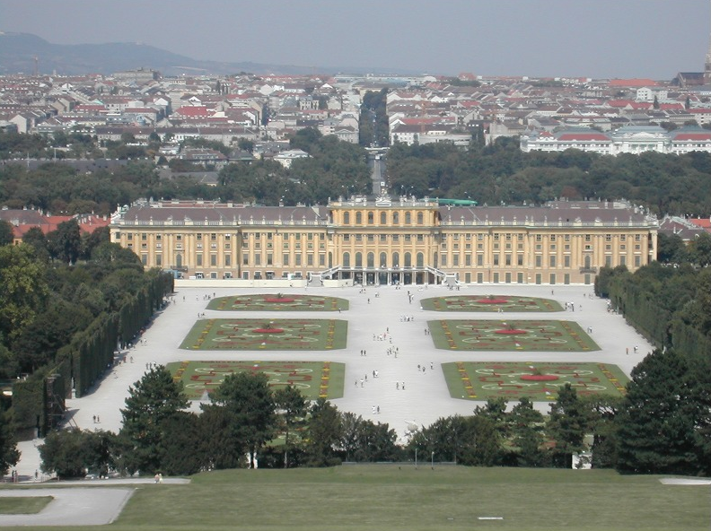
Schönbrunn Palace

Slide 7
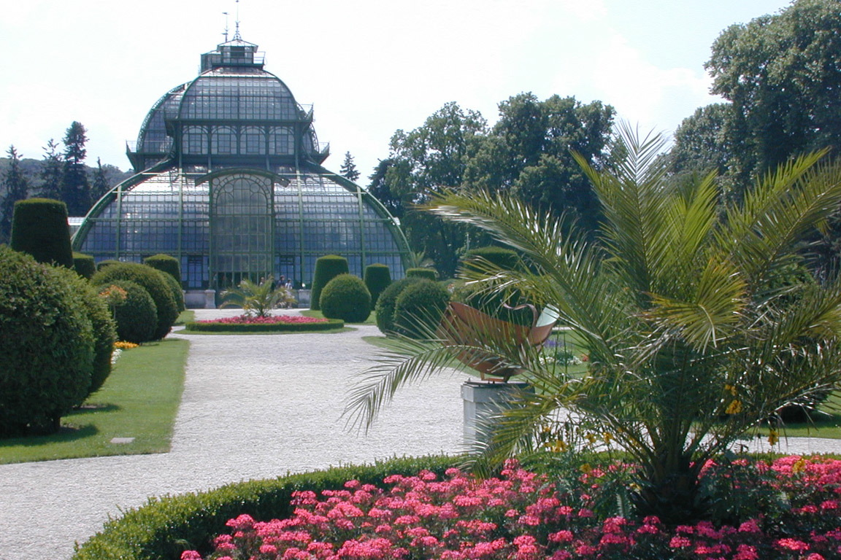
Schönbrunn Palace

Slide 8
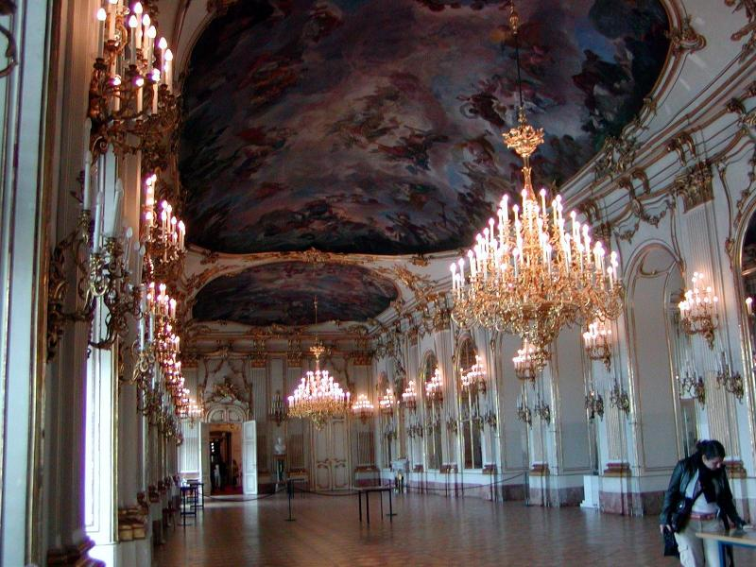
Schönbrunn Palace

Slide 9
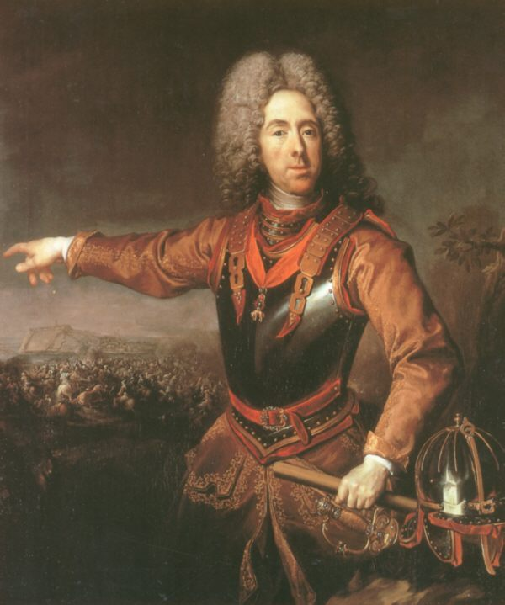
Prince Eugène of Savoy: 1718

Slide 10
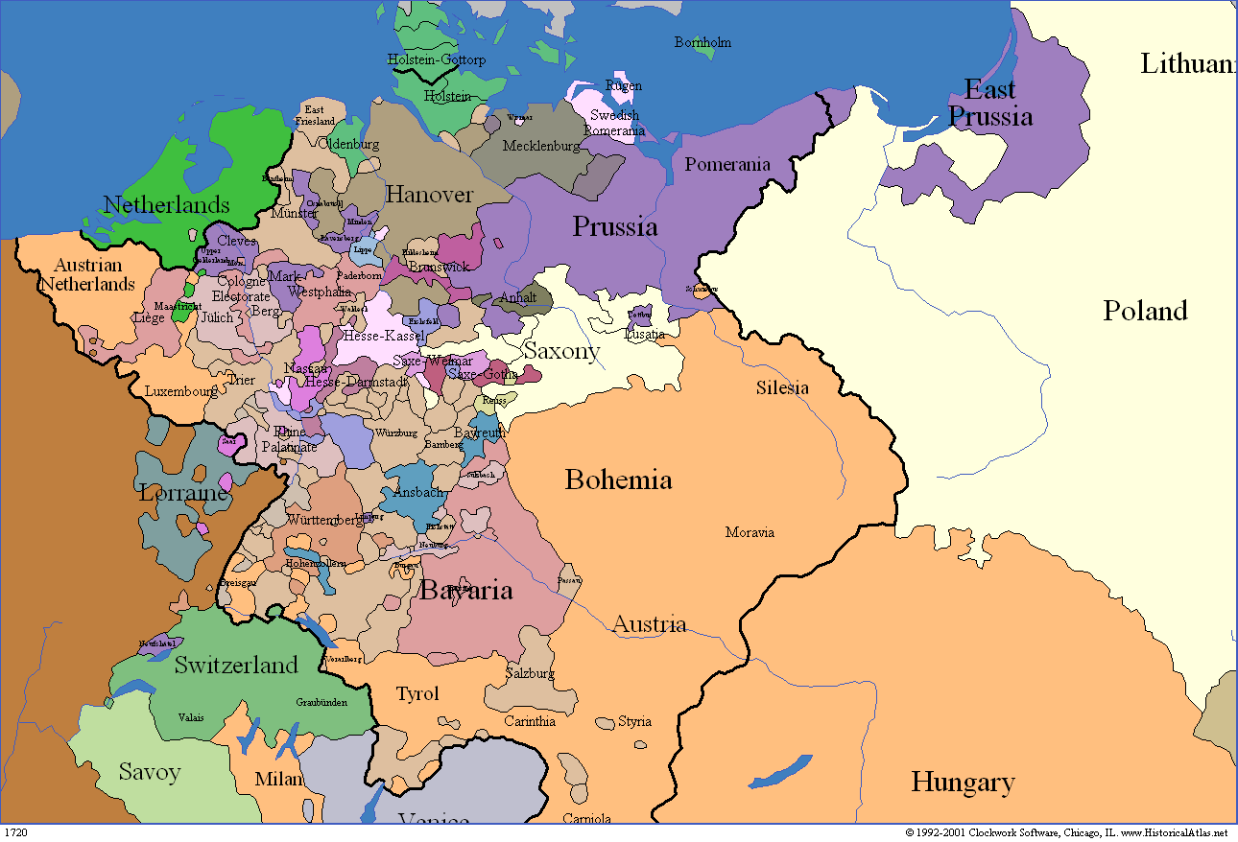
Holy Roman Empire: 1750

Slide 11
The Hohenzollerns
&
Brandenburg-Prussia

Slide 12
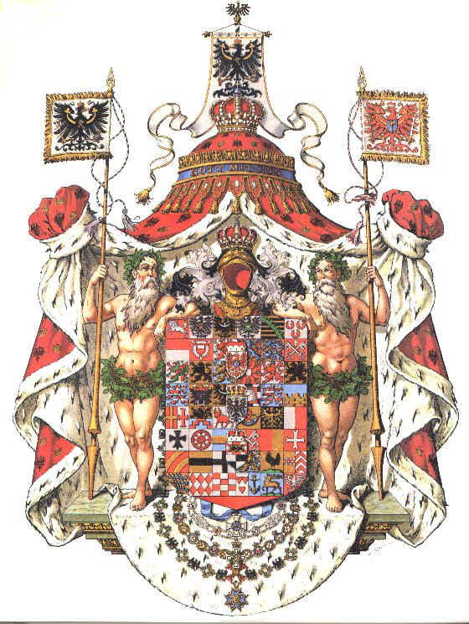
Prussian Family Crest

Slide 13
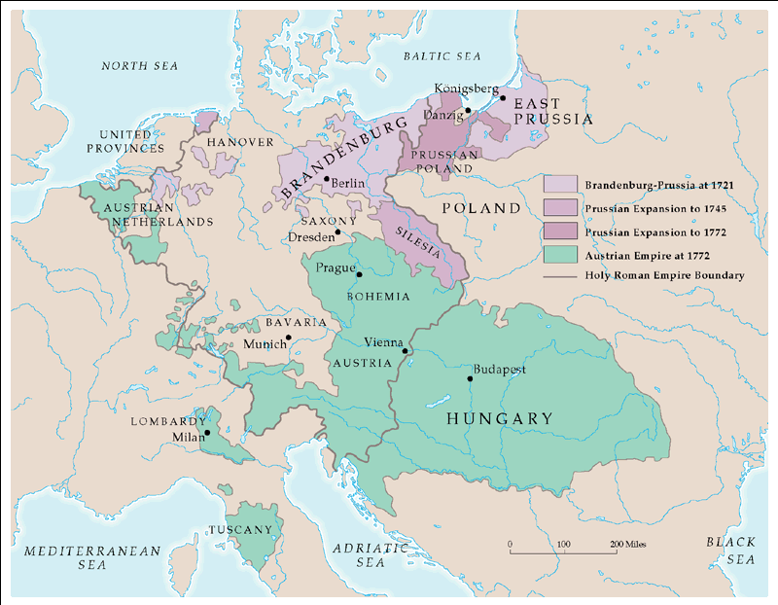
Prussia & the Austrian Empire: 1721-72

Slide 14
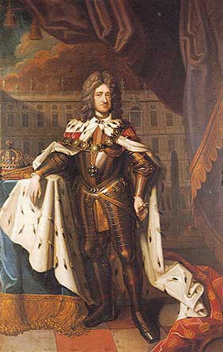
King Frederick I of Prussia (r.1701-1713)
Formerly:
Frederick III of Brandenburg
(r. 1688-1701)

Slide 15
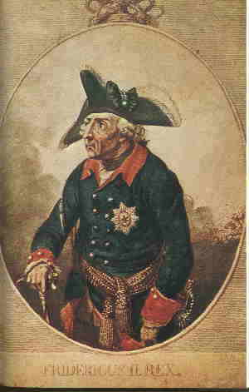
Frederick the Great (r. 1740-1786)

Slide 16
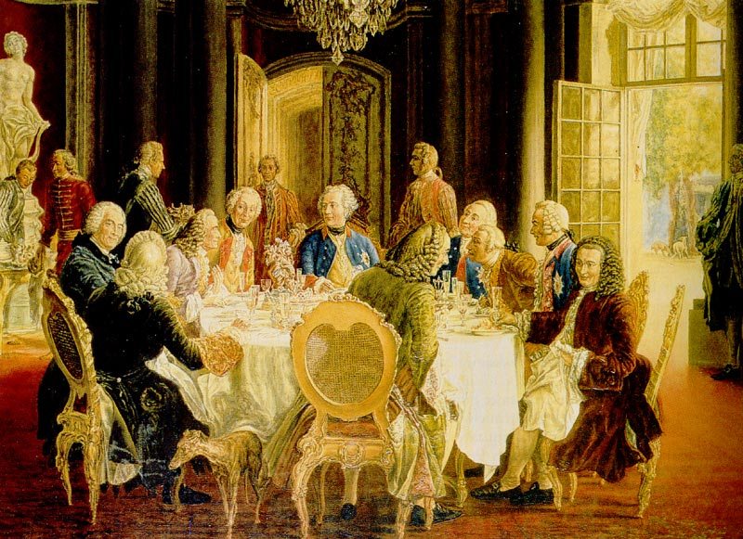
Frederick the Great (r. 1740-1786)

Slide 17
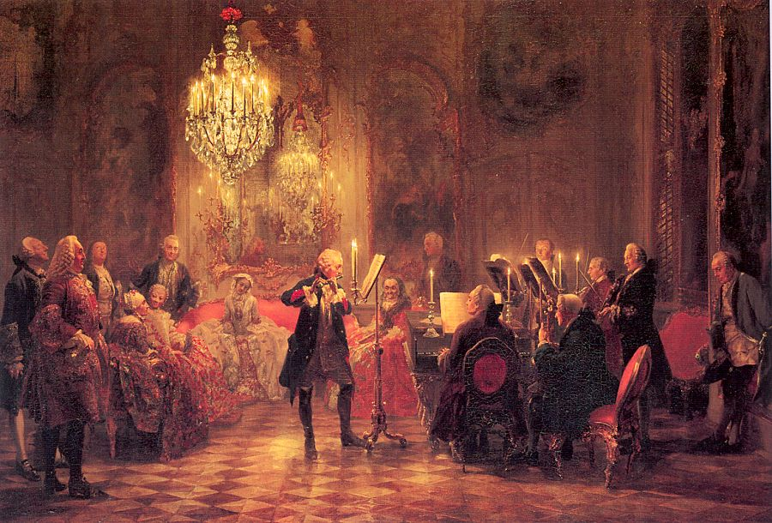
Frederick the Great’s Court

Slide 18
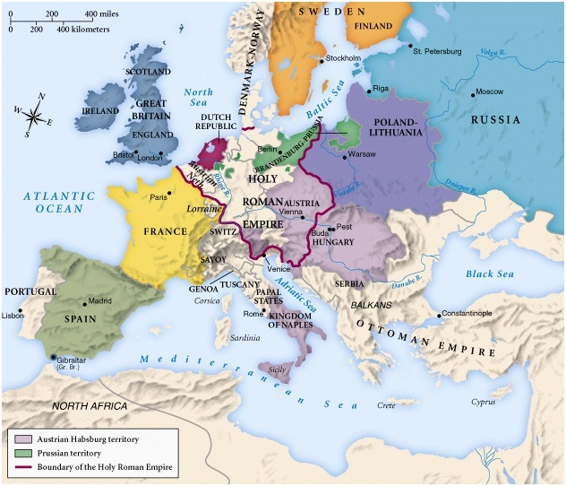
Europe in 1740

Slide 19
The War of the
Austrian Succession
1741 - 1748

Slide 20
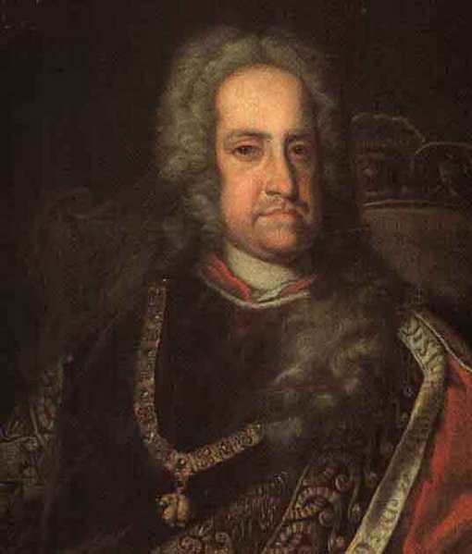
Charles VI (r. 1711-1740)

Slide 21
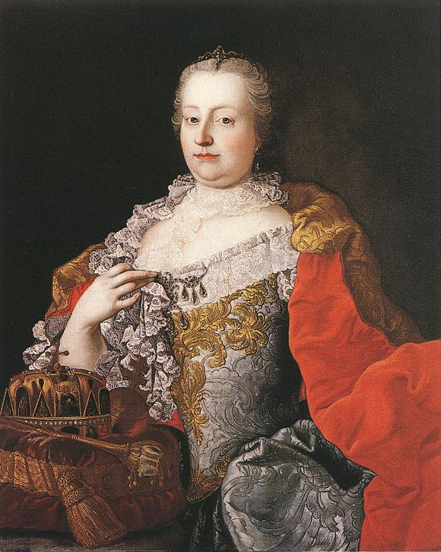
Maria Theresa
(r. 1740-1780)

Slide 22
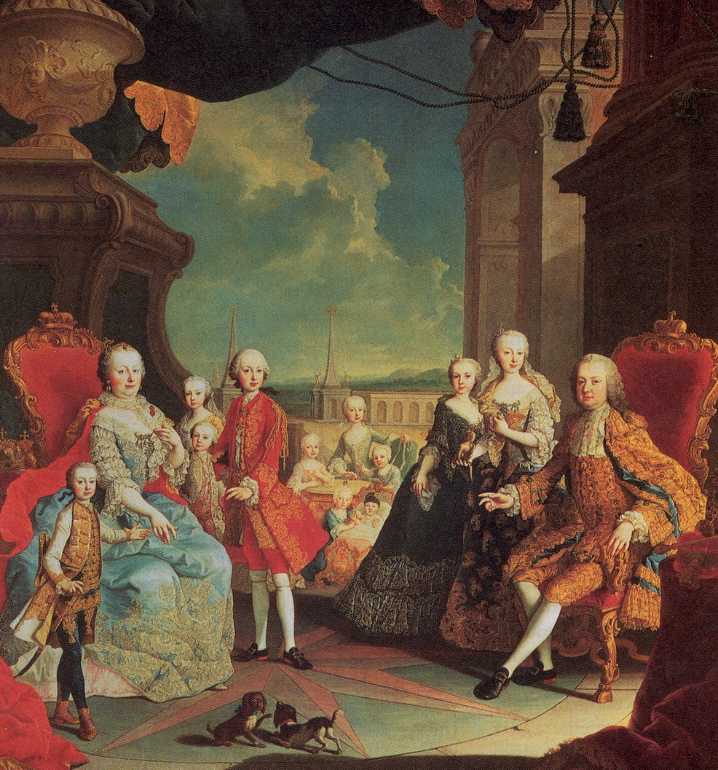
Maria Theresa & Her Family
Her Notable Children:
HRE Joseph II
HRE Leopold II
Queen Marie Antoinette (Fr.)

Slide 23
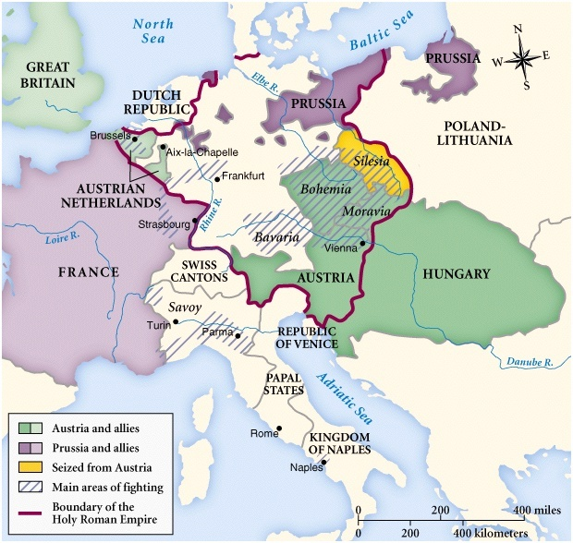
War of the Austrian Succession

