Slide 1
Absolutism
A form of government, usually within a monarchy, in which the ruler exercised absolute power over virtually all facets of his or her kingdom.

Slide 2
Absolute monarchs controlled:
Government and law
Religion
Economic policy
Military
Culture of the country

Slide 3
In order to be an absolutist, the monarch needed to eliminate all competition within the country:
No courts to overrule his or her decision
No armies to threaten stability
No nobles powerful enough to successfully scheme against the crown

Slide 4
Absolutism streamlined the governing of a nation and reduced the time it took to make and act on decisions.
For the monarch, absolutism was ideal in times of crisis, war, or revolution.

Slide 5
When was the Age of Absolutism?
Seventeenth century.
Which countries had absolute monarchs?
France
Austria
Russia
Prussia
Spain (decline of monarchy)
England (constitutionalism)

Slide 6
Absolutism in France
Height of Absolutism occurred between the 17th and 18th Centuries
The Monarchs of France were the epitomy of the absolute monarchs
Louis XIII, Louis XIV, Louis XV, Louis XVI
These absolute monarchs ruled from the Palace of Versailles just outside Paris.

Slide 7
How they gained power:
Controlled taxation: Intendants
Hired large professional armies to increase their control and conquer new territory.
Crushed resistance of nobles when they rebelled.
Crushed resistance of Protestant Huguenots – Edict of Nantes revoked.
Palace of Versailles – isolate nobles.

Slide 8
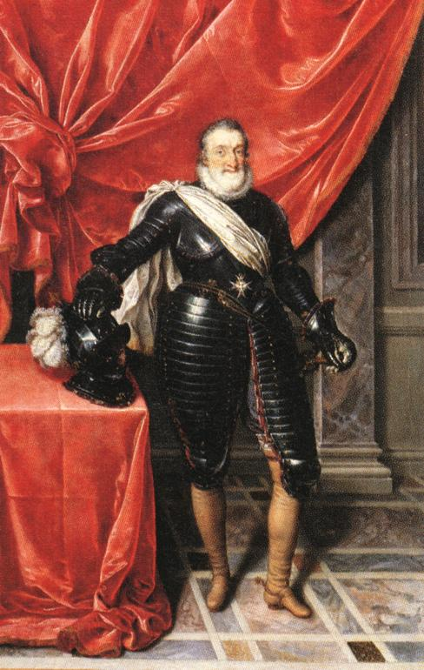
Henry IV of Navarre
1589-1610

Slide 9
Enacted the Edict of Nantes, guaranteeing religious liberties to the Huguenots and ending the civil war.
To suppress opposing nobles, Henry had them paid off in order to prevent wars.
He adopted policies and undertook projects to improve the lives of all subjects, especially workers and peasants.

Slide 10
Appointed the Duke of Sully as his chief minister.
Lowered the taxes for French peasants
Regularize state finance
Promote agriculture
Drain swamps to create crop lands
Undertake many public works
Encourage education and create colleges

Slide 11
Henry IV renewed Paris as a great city.
Promoted the arts by all classes of people.
Financed expeditions to North America that saw France claim Canada.
Henry IV was assassinated in Paris by Francois Ravaillac who stabbed the king to death while he rode in his coach

Slide 12
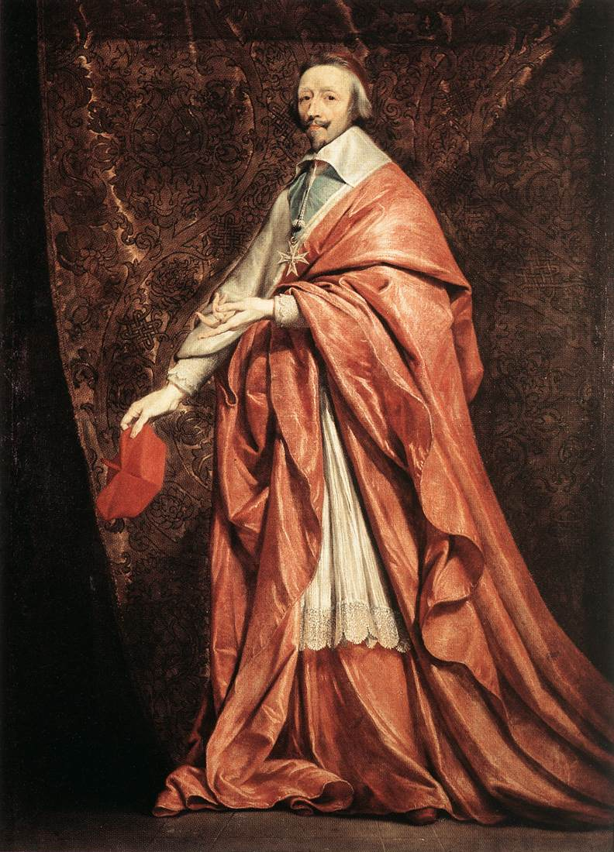
Henry IV assassinated in 1610
Henry’s son, Louis XIII, was 8 and too young to rule
Affairs run by Catholic cardinal:
CARDINAL RICHELIEU
Responsible for increasing the power of the French monarchy:
Encouraged nobility to trade
Made it possible for merchants to buy titles of nobility
Founded commercial trading companies
Prohibited private warfare and ordered destruction of all fortified castles

Slide 13
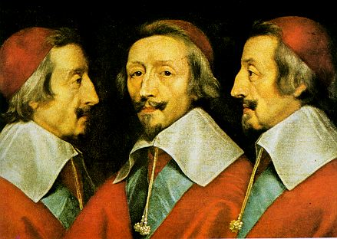
Cardinal Richelieu
Louis XIII’s chief minister from 1624-1642
Devoted himself to strengthening the power of the monarchy.
Weakens the power of the Habsburgs
Weakens power of the nobles – increases the power of the intendants

Slide 14
Indendents:
Individuals in the 32 provinces of France who were appointed by the king to carry out royal orders, collect taxes, preside over judicial hearings, and recruit soldiers. This system weakened the nobility and strengthened the monarchy.

Slide 15
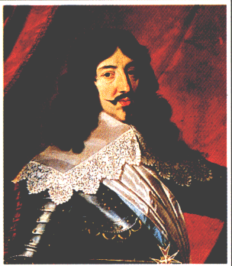
Louis XIII 1610-1643
Took control of government at age 15
Gained control of the nobility
Made Richelieu his chief minister from 1624-1642
Overturned the power of the Protestant Huguenots by retracting the Edict of Nantes.

Slide 16
Strengthened royal authority and centralized government control.
Began building a powerful army capable of dominating Europe.
Promoted the arts.
Organized the development and westward expansion of New France in North America to Montreal.
Was married to a Habsburg princess, Anne of Austria, daughter of King Philip III of Spain

Slide 17
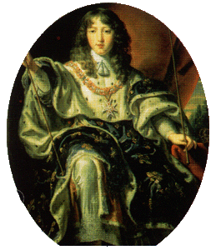
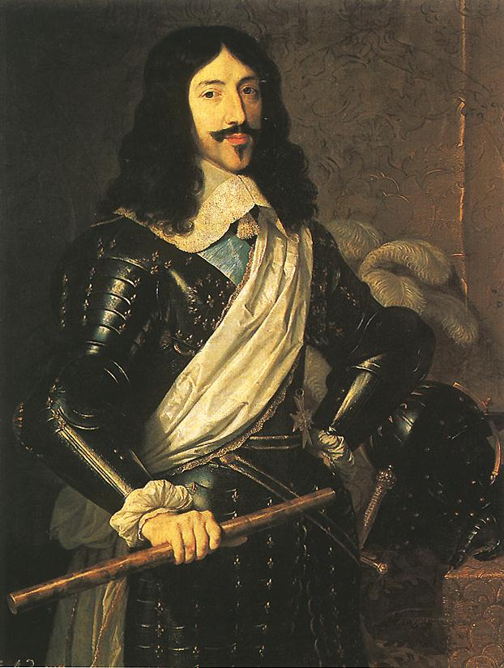
Louis XIII died in 1643
Louis XIV, his son, was only 4 years old and too young to rule
Cardinal Mazarin lead France until Louis XIV was old enough to take over

Slide 18
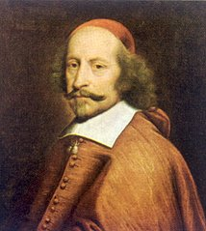
Mazarin died in 1661
Was an Italian-turned-French citizen and Cardinal of the Catholic Church

Slide 19
Was chosen as chief minister by Louis XIII to follow Richelieu and learned his political philosophy
With the death of Richelieu and Louis XIII, Mazarin became the “ruler”. He continued Richelieu’s anti-Habsburg policy and strengthening of the central government.
Was successful in foreign policy- added territory to France in the Treaty of Westphalia

Slide 20
Was a failure in domestic policy
Failed to control the nobility
Faced backlash over rising taxes and a failing economy
French rebelled in civil wars known as the Fronde
Mazarin was chased from France twice, but eventually prevailed and helped pave the way for the reign of Louis XIV
Died in 1661, Louis XIV became the ruling monarch

Slide 21
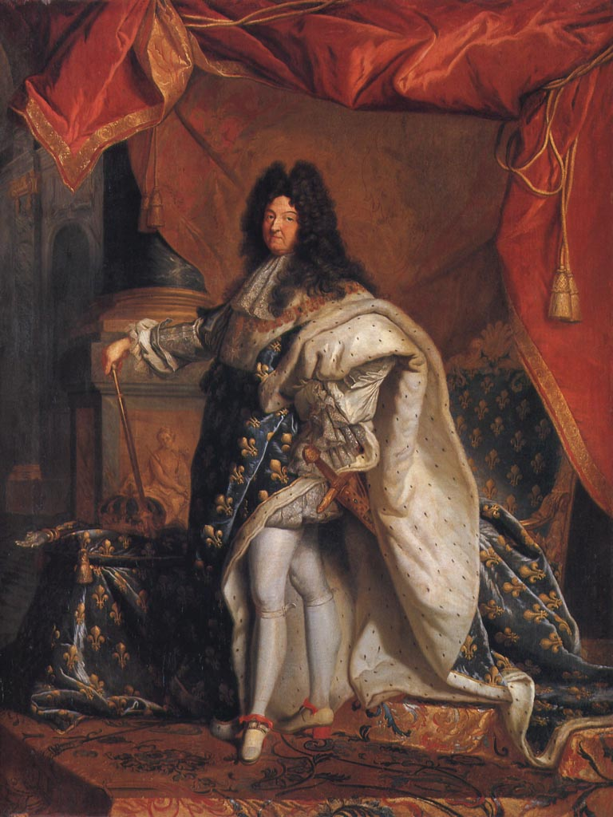
“The Sun King”
LOUIS XIV 1638-1715

Slide 22
Ruled France from 1643-1715, longest reign in European history.
As a youth, he read diplomatic papers, learned geography, and watched those around him conduct state affairs.
He grew to believe that the nobility could not and should not be trusted.
He learned from Mazarin (who learned from Richelieu) the importance of being a grand and powerful monarch

Slide 23
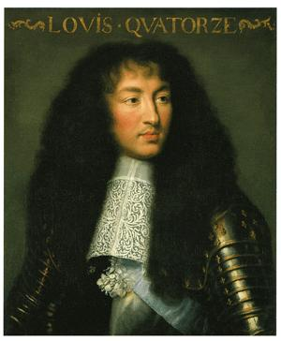
Louis basked in the grandeur of king and craved the attention of the nobles
He embraced the idea that God placed monarchs on thrones and they were intended to be God’s earthly rulers and supported the Catholic cause.
He defined absolutism during his reign.

Slide 24
A strong central government was the #1 goal of Louis’ reign.
He decided to convince the nobility to work with him rather than confronting and subduing them.
He planned to control the nobility without them realizing it.
He convinced the wealthy nobles to support measures that benefited themselves and the monarchy.
He eventually convinced the nobility of his grandeur and nobles would do anything to be in his presence.
He used the palace at Versailles to accomplish it.

