Slide 1
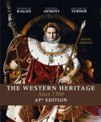
The Western Heritage Since 1300
Chapter 12: The Age of Religious Wars Pg# 351-378

Slide 2
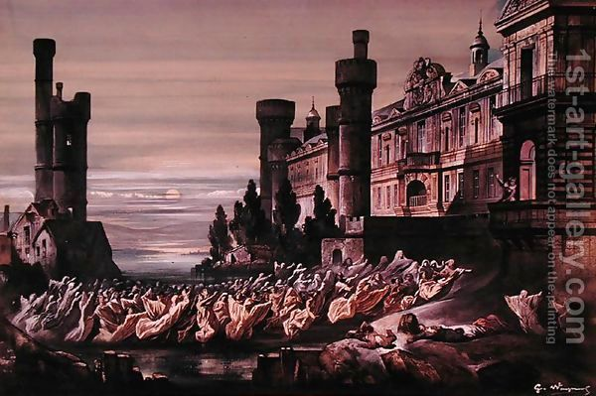
Key Topics:
The War between Calvinists & Catholics in France
The Spanish occupation of the Netherlands(Holland)
The struggle for supremacy between England and Spain
The devastation of central
Europe during the
Thirty Years’ War

Slide 3
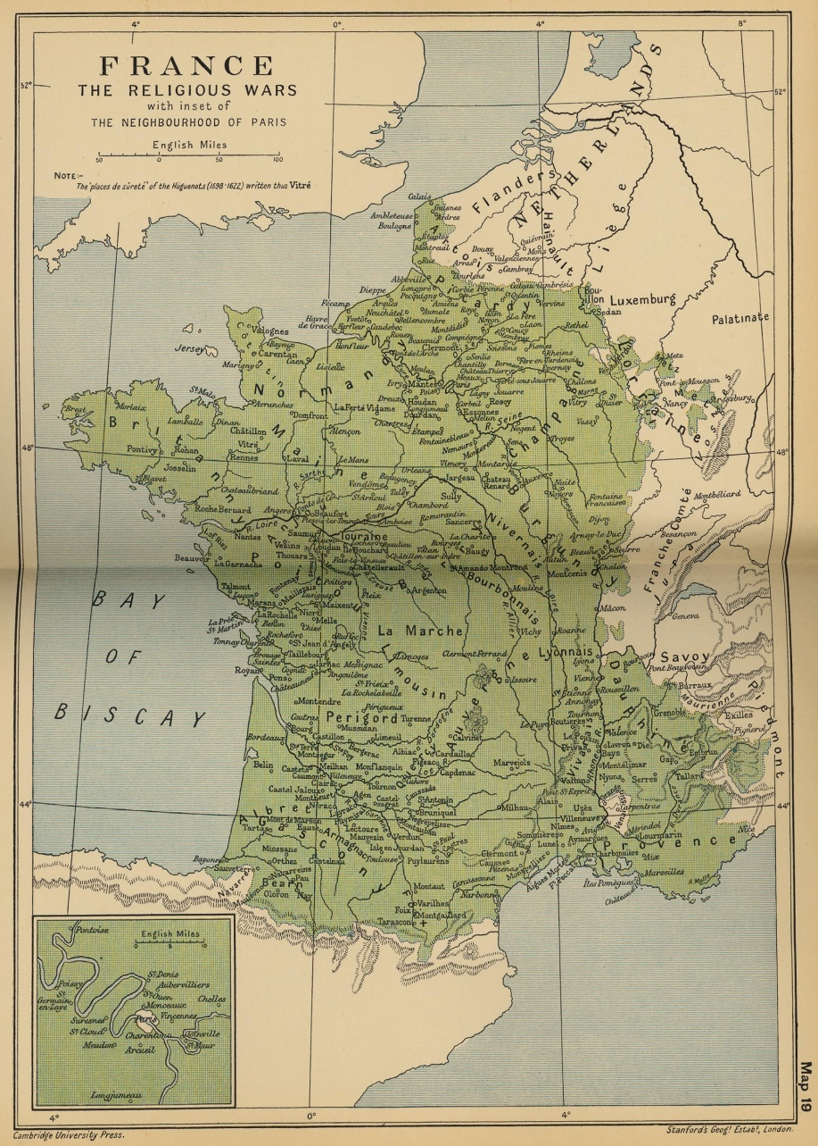
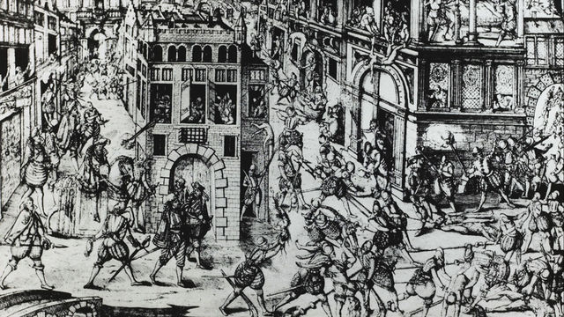
Chapter Outline:
Renewed Religious Struggle
The French Wars of Religion (1562-1598)
Imperial Spain and Philip II (1556-1598)
England and Spain (1553-1603)
The Thirty Years’ War (1618-1648)

Slide 4
Europe

Slide 5
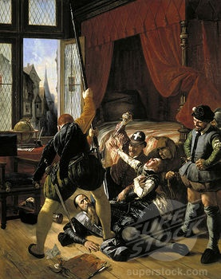
Vocabulary:
Presbyters
skepticism
relativism
Thirty Years’ War
Huguenots
Habsburg
colloquy
synod
Edict of Nantes
Fuggers
escorial
regicide
semi-autonomous
hierarchical
secular principalities
Imperial Diet
Treaty of Westphalia
baroque
congregationalist
Counter-Reformation
politique
Presbyterians
Thirty-Nine Articles (1563)

Slide 6
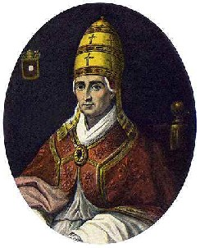
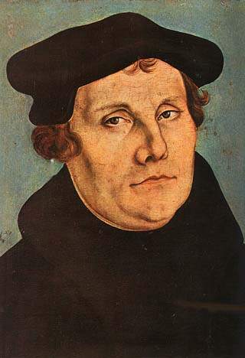
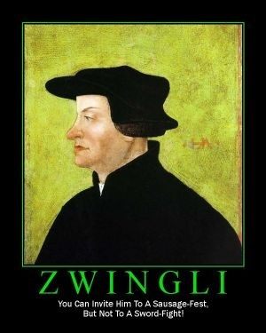
Renewed Religious STruggle
Roman Catholic Church
vs
Protestantism

Slide 7
Map of Europe: 16th & 17th Century

Slide 8
St. Bartholomews Day Massacre
https://www.youtube.com/watch?v=vwjAb9T6qIs

Slide 9
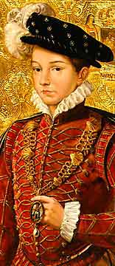
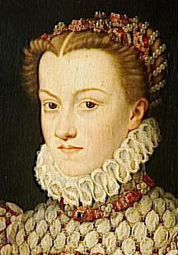
The French Wars of Religion
Catholicism vs Protestantism in France
1. French Protestants known as
Huguenots, derived from Besancon
Hugues, leader of Geneva’s political
revolt against House of Savoy in the
1520’s
2. Anti-Protestant feelings throughout
France common, persecution as well.
3. 1540, Edict of Fontainbleau subjected
French Protestants to Inquisition
a. Catholic imprisonment/torture to
recant Protestant beliefs
4. French monarchs including Henry II
(1547-1559), enacted laws against
Protestant worship/public gatherings
5. Henry II’s death due to accident, son
took over only to die a year later,
opened rule for other families of France
Henry II of France
Francis II
Catherine de Medici

Slide 10
The French Wars of Religion
Home of Henry II of France & Catherine de Medici

Slide 11
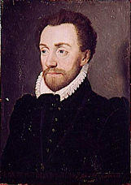
The French Wars of Religion
6. Three families vied for control of France:
a. Bourbons (south & west)
b. Montmorency-Chatillons (center)
c. Guises (east)
7. Guise family controlled Francis II, the
son of Henry II, as two brothers Cardinals in
Church, one Henry’s top general, also related
to Mary, Queen of Scots, widow of Francis II,
son of Henry, all known as reactionary militant
Catholics
8. aBourbon & bMontmorency-Chatillon families
formed ties with Huguenonts
a. Bourbon prince Louis I, Prince of Conde
b. Admiral Gaspard de Coligny
c. both political leaders of French Protestant
resistance
Admiral Gaspard de Coligny
Louis I, Prince of Conde

Slide 12
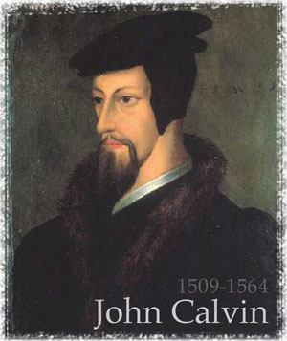
Appeal of Calvinism
1. Huguenots (Protestants) a minority religion
in France
a. 1561, 2,000 Huguenot congregations
in France
b. only a majority in two regions of France-
Dauphine & Languedoc
c. 2/5’s French aristocracy Huguenot
2. Calvin justified & encouraged resistance of
Huguenots against Catholic rule in France,
made Protestant religion viable in France

Slide 13
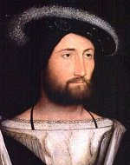
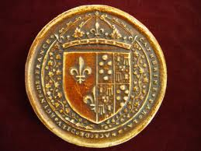
Catherine de Medici & the Guises
1. Catherine became regent to Francis II
as Francis too young to rule independently
2. Attempts to reconcile Catholic vs
Protestant issues failed, goal to preserve
monarchy
3. 1562, issued January Edict, which granted
Protestants right to worship publicaly
outside towns-though to worship inside
while in towns and hold synods(mtg of
Protestant churches)
4. Duke of Guise surprised Protestant
congregation at Vassy (Champaigne) and
killed several worshippers
5. Beginning of French Wars of Religion
Francis II
Catherine de Medici
Duke of Guise

Slide 14
Catherine de Medicis
https://www.youtube.com/watch?v=zjKBax-tu-M

Slide 15
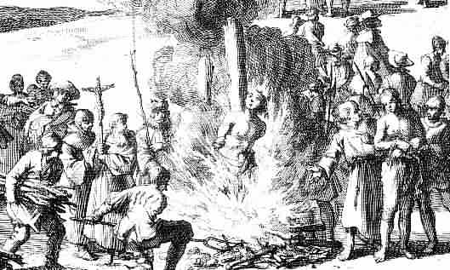
The Peace of Saint-Germaine –en-Laye
Series of Wars:
a. April 1562-March 1563
Duke of Guise assassinated
b. 1567-1568
c. September 1568-August 1570
Louis I, Prince of Conde killed
Huguenot leadership passed to
Coligny

Slide 16
The Peace of Saint-Germaine –en-Laye
2. Peace of Saint-Germaine, 1570
French crown recognized Huguenot political &
military power
a. Huguenots granted religious freedom, right
to fortify their own cities
3. Political intrigue as Catherine, a Catholic, sought
to balance power between Huguenots &
Bourbons
a. she wanted to prevent Huguenot support for
Dutch Protestants, including military assistance
because Spain controlled the Netherlands,
which would have meant war between France
and Spain, and France was weaker.
Queen Catherine de Medici

Slide 17
St. Bartholowmew’s Day Massacre
https://www.youtube.com/watch?v=yTC_s_YWIFI

Slide 18
Saint Bartholomew’s Day Massacre
1. Catherine part of plot to kill Admiral
Gaspard de Coligny as he was shot by assassin.
a. convinced Charles, Holy Roman Emperor that Huguenot plot to take over France, inspired by Coligny, and to execute all Huguenot leaders
2. August 24, 1572, Coligny & 3,000
others butchered in Paris
a. 20,000 killed overall in France by French Catholics
b. Pope Gregory XIII & Philip of Spain greeted news with celebrations
c. Philip happy as prevented France from interfering with Netherlands Protestants
d. St. Bartholomew’s Day massacre became symbol of Catholic oppression over Protestants, world-wide

Slide 19
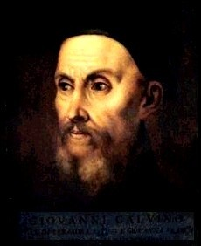
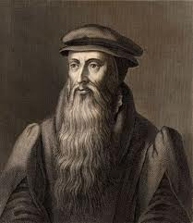
Protestant Resistance Theory
1. Protestant theory of active resistance
against oppression
a. Luther only approved active resistance
after Diet of Augsburg, 1530
b. 1550, Lutherans published paper
defending right of lower authorities to
oppose Emperor’s order that all
Lutherans return to Catholic fold
c. Calvin taught that lower magistrates had
right to oppose tyrannical higher
authority
d. John Knox, who suffered defeat at the hands of Mary, Queen of Scots, (Catholic) wrote First Blast of Trumpet against the Terrible Regiment of Women (1558), declared removal of heathen tyrant was
permissible & Christian duty

Slide 20
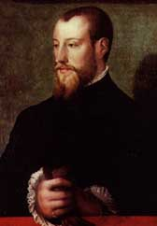
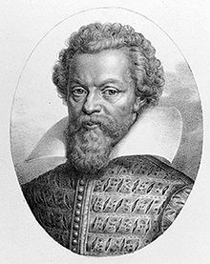
Protestant Resistance Theory
2. Francios Hotman wrote Franco-Gallia, 1573,
based on theory that French Estates General
held higher power than French Kings
3. Theodore Beza wrote On the Right of
Magistrates over Their Subjects, (1574),
justified correction and even overthrow of
tyrannical rulers by lower authorities
4. Philippe du Plessis Morney wrote Defense
of Liberty against Tyrants, (1579), admonished
princes, nobles, magistrates beneath king as
guardians of the rights of the body politic,
to take up arms against tyranny in other lands

Slide 21
The Rise to Power of Henry of Navarre
1. Henry III of France (1574-1589), attempted
to steer middle course between Huguenots &
a radical Catholic League, formed in 1576 by
Henry of Guise
a. Henry received support from moderate
Catholics & Huguenots who felt survival
of France greater than religious civil war,
this politique was prepared to offer
compromise between religions
2. Peace of Beaulieu, May 1576, granted
Huguenots almost complete religious freedom
3. Peace would not last as Catholic League
forced Henry to return to quest for absolute
religious unity in France
a. Henry removed Peace of Beaulieu, October
1577, again limited Huguenot worship
4. Religious war once again between Catholics &
Huguenots
Henry III of France

Slide 22
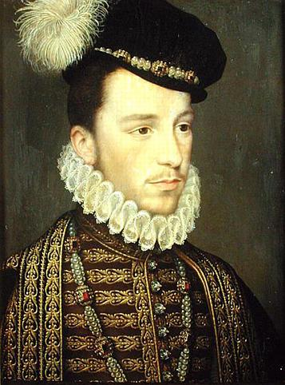
The Rise to Power of Henry of Navarre
5. “Day of the Barricades”, Henry’s attempt to route Catholic
League failed, Henry fled Paris, reduced to fighting with
guerrilla tactics against stronger opponent
a. Had Duke & Cardinal of Guise assassinated upon hearing of
English victory over Spanish Armada in 1588
b. Another Guise led Catholic League against Huguenots, another massacre similar to earlier St. Bart’s massacre
c. Henry struck alliance with Henry of Navarre, Protestant
6. Henry III killed by Catholic Dominican Friar after which meant
Henry of Navarre became Henry IV(1589-1610)
7. Spanish troops were sent to support French Catholic League as
Spain and Pope did not want Protestant France
a. Henry IV, popular with the troops, tired of religious fighting,
focused on political peace over religious unity
8. July 25, 1593, publically abandoned Protestant faith, embraced
traditional & majority religion of France “Paris is worth a mass”,
as felt religious tolerance best way to achieve peace
a. Protestants horrified, Pope Clement VIII skeptical, though
French sided with Henry IV.
b. Catholic League disbanded, 1596, Wars of Religion over
Henry III of France
Henry of Navarre(Henry IV)

