Slide 1
The New Monarchies: 15^{c} – 16^{c}
Ms. Susan M. Pojer Horace Greeley H.S. Chappaqua, NY

Slide 2
Characteristics of the New Monarchies
They offered the institution of monarchy as a guarantee of law and order.
They proclaimed that hereditary monarchy was the legitimate form of public power → all should accept this without resistance.
They enlisted the support of the middle class in the towns → tired of the local power of feudal nobles.
They would have to get their monarchies sufficiently organized & their finances into reliable order.

Slide 3
Characteristics of the New Monarchies
They would break down the mass of feudal, inherited, customary, or “common” law in which the rights of the feudal classes were entrenched.
The kings would MAKE law, enact it by his own authority, regardless of previous custom or historic liberties → What pleases the prince has the force of law!

Slide 4
England → stability under the Tudors
France → consolidation of power.
Spain → unification by marriage.
HR Empire → different model: the cost of decentralization.

Slide 5
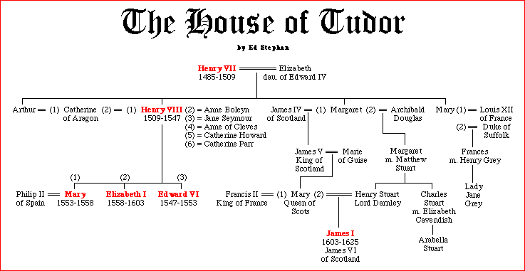
The Tudors of England

Slide 6
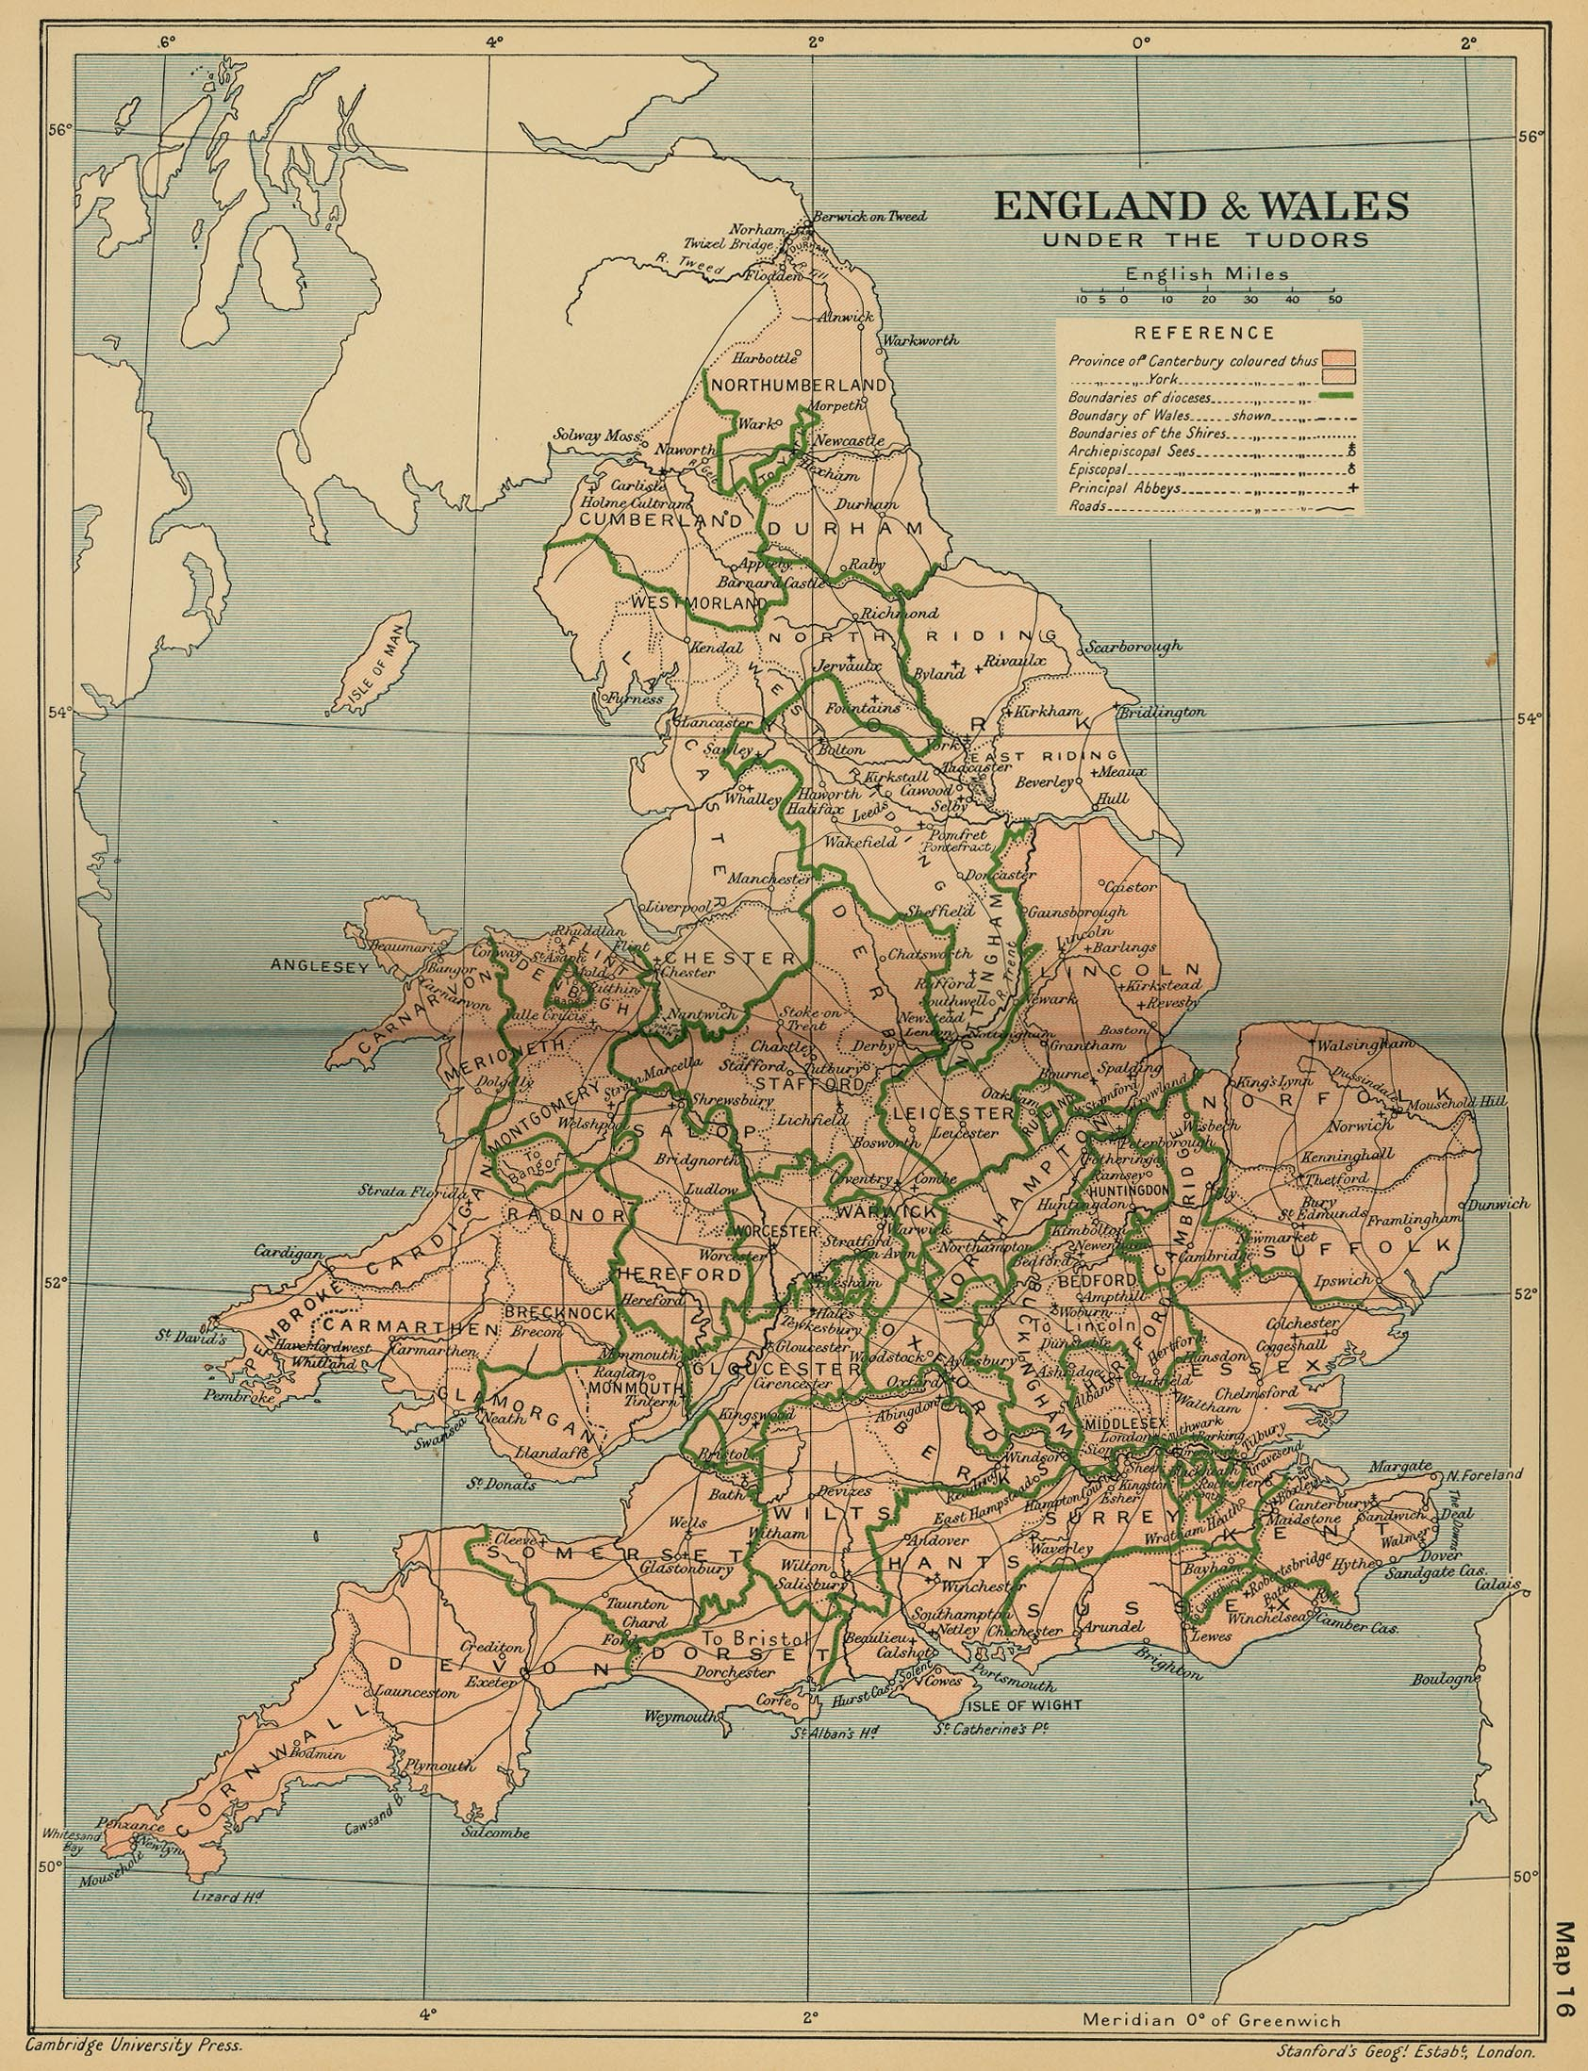
Tudor England 1485

Slide 7
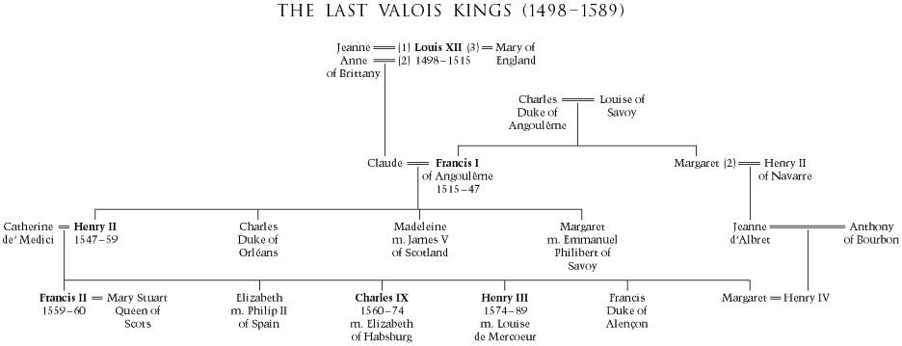
The Valois Dynasty in France

Slide 8
France in the 15^{c} – 16^{c}

Slide 9
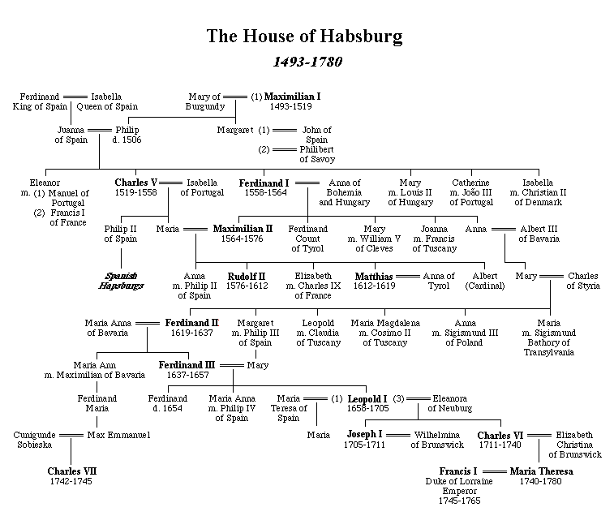
The Habsburg Dynasty

Slide 10
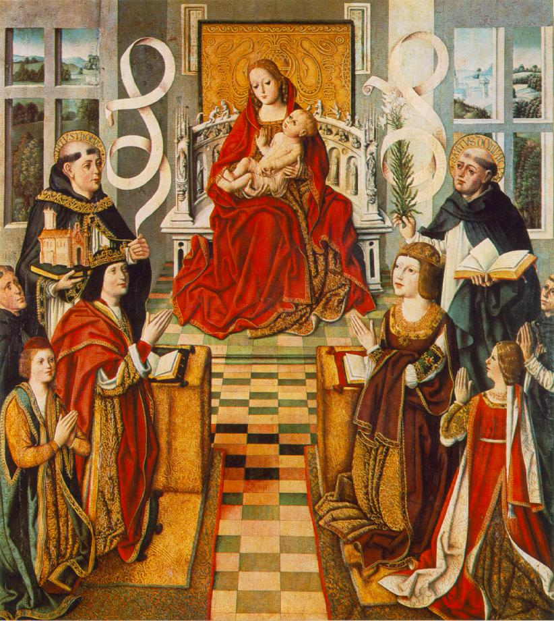
Ferdinand & Isabella of Spain
The Madonna of the Monarchs

Slide 11
Kingdoms of Spain: 1492

Slide 12
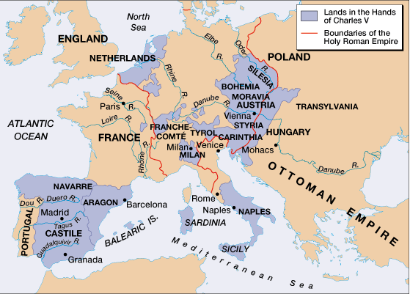
Empire of Charles V

Slide 13
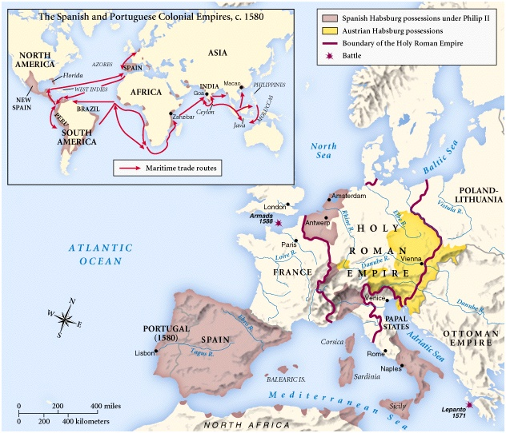
The Empire of Philip II

Slide 14
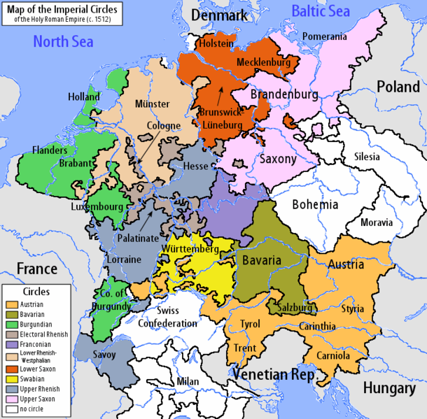
The Holy Roman Empire: Late 1512

Slide 15
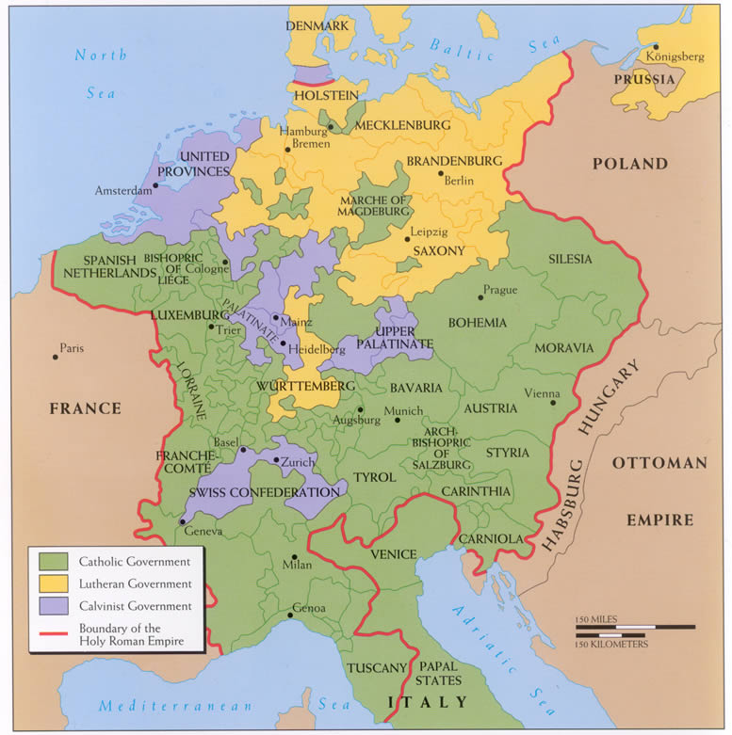
The Holy Roman Empire: Late 16^{c}

Slide 16
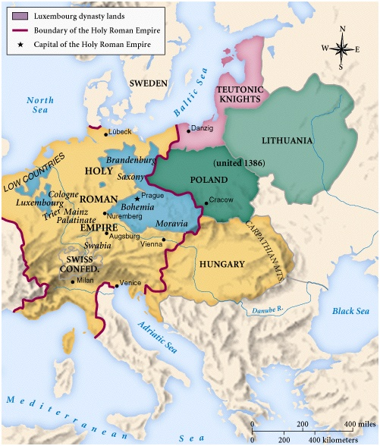
Central Europe in 1600

Slide 17
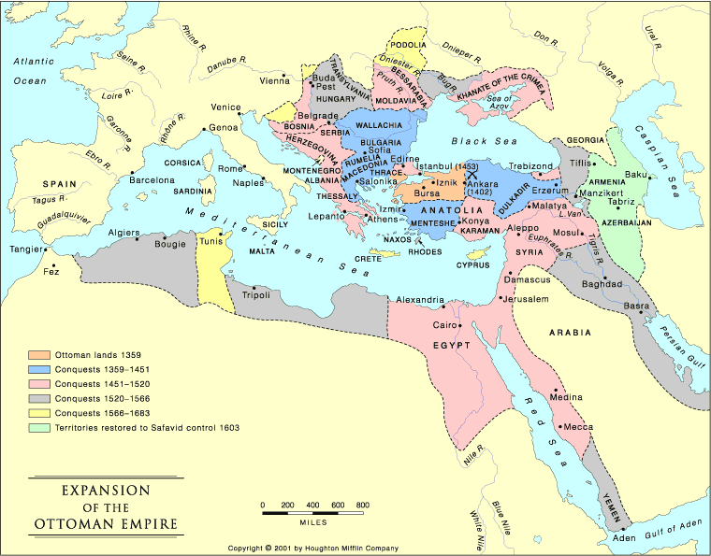
The Growth of the Ottoman Empire

Slide 18
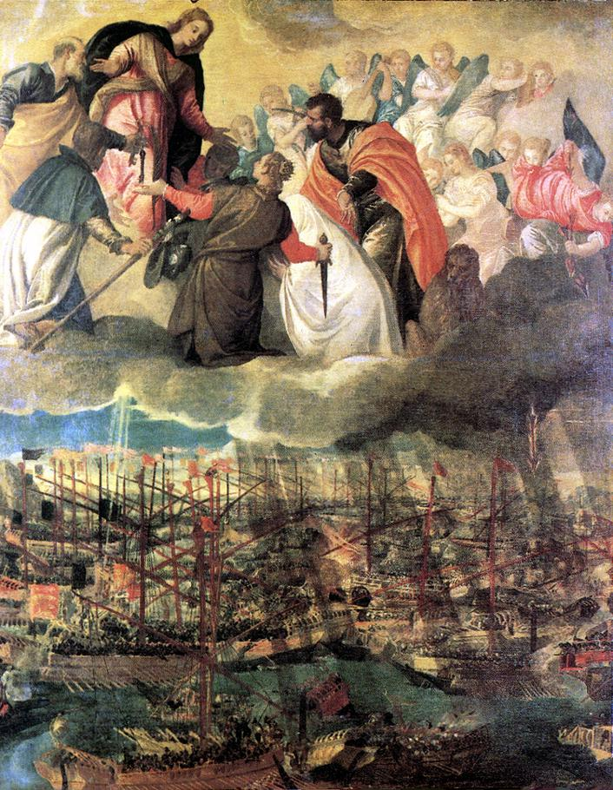
The Battle of Lepanto, 1571

Slide 19
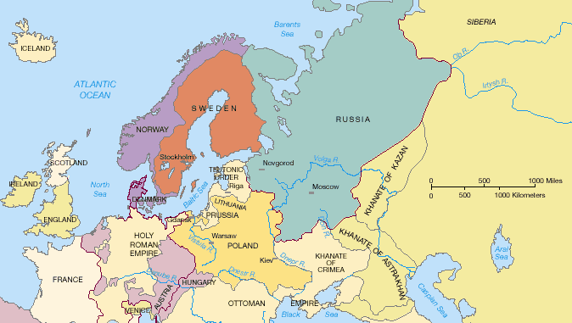
Eastern Europe in 1550

