Slide 1
European Art Movements
By Ami Hayashi

Slide 3
Baroque
Began around 1600
Rome, Italy
Encouraged by Roman Catholic Church
Prominent religious themes
Emotional involvement
Aristocracy saw Baroque architecture and art as means to express triumph, power, opulence, and control
Characteristics:
Exaggeration
Drama
Grandeur
Found in:
sculpture
painting
architecture
literature
dance
music

Slide 4
Famous Baroque Artists
Art
Music
Peter Paul Rubens- most famous Baroque artist who studied Michelangelo in Italy and whose Renaissance style brought art to the next level of drama, motion, color, religion and animation
Johann Sebastian Bach- Lutheran Organist and choirmaster who is most famous in Germany and is credited for the best Baroque compose
George Fredrick Handel- German, Baroque, Lutheran composer who is internationally famous for his invention of the Oratorio. The oratorio is very famous in England because it is a simple performance of religious music

Slide 5
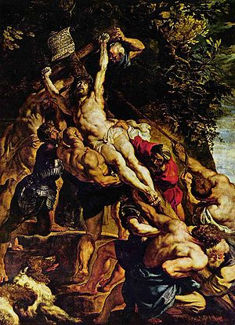
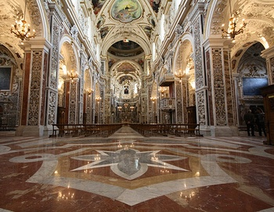
Famous Baroque Style Pieces
Jesuit Church of Jesus in Rome (the Gesu) (1551) concieved by Saint Ignatius of Loyola
(1610-1611) Peter Paul Rubens, The Elevation of the Cross

Slide 6
Rococo “Late Baroque”
18th century (1700-1780)
“ancient regime art”
Reaction against the grandeur, symmetry and strict regulations of the Baroque
More florid, graceful, and ornate with more witty and playful themes.
Heavily criticized for being too frivolous and superficial
Includes:
Painting
Sculpting
Architecture
Interior design
Decoration
literature,
Music
Theatre

Slide 7
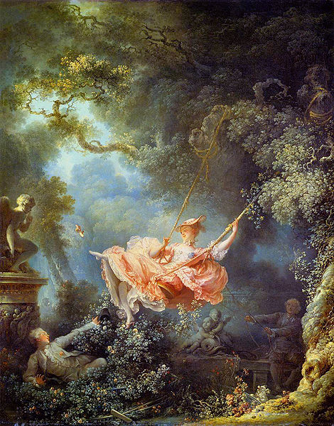
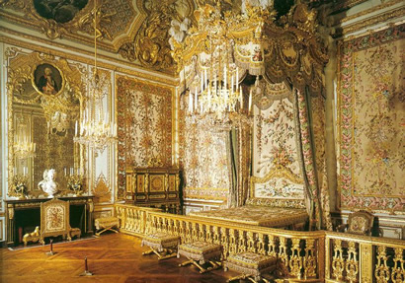
Famous Rococo Artists
Art
Architecture
Jean-Honoré Fragonard- French painter whose art is distinguished by exuberance and eroticism
Palace of Versailles
The Swing (1767) Jean-Honoré Fragonard

Slide 8
Neoclassicism
Return to classic antiquity, spirit of classical period and product of Enlightenment era thought
18th century to 21st century influence
“academic art”
Showcased at Paris salons
Mainly influential in France
Characteristics:
Formal
Imperial style
Imitation of Greek and Roman Art
Found in:
Visual arts
Literature
Theatre
Music
Architecture

Slide 9
Famous Neoclassicism Artists
Jacques-Louis David- depict art as moral seriousness, emphasis on honor, patriotism
Cesare Beccaria- wrote On Crimes and Punishments, 1764 which argued that punishment should not be exercises on brutality; against capital punishment because it failed to stop others from committing crimes and is an example of barbarism
Franz Joseph Haydn- 104 symphonies + string arrangements and compositions; dedicated to common people
Wolfgang Amadeus Mozart- musician, prodigy; could not find patron in Vienna; died at 35
Art and Literature:
Music:

Slide 10
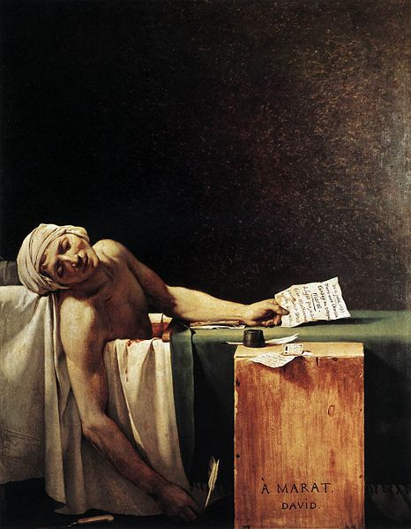
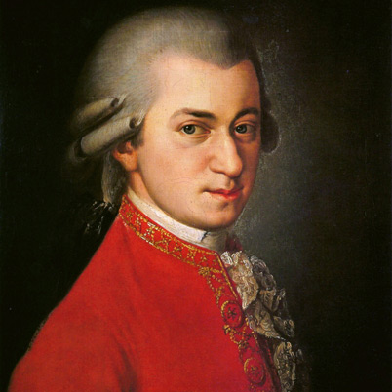
Famous Neoclassic Pieces
“People take different roads seeking fulfillment and happiness. Just because they're not on your road doesn't mean they've gotten lost.” –Cesare Beccaria
Death of Marat by David (1793)
Wolfgang Mozart

Slide 11
Romanticism
French Revolution Era, partly as a reaction to industrial revolution
Revolt against aristocratic social and political status during Age of Enlightenment and Natural Sciences
Evokes emotions and passion
Influenced by dreams, folklore, imagination
Rejects Locke, Hobbes ideals of the world
Found in:
Art
Literature
Intellectual movement
Characteristics:
Heroes
Individuality
Power of nature
Emotion
Love
Nationalism
Escape

Slide 12
Famous Romantic Era Artists
Caspar David Friedrich- was a German Romantic landscape painter, generally considered the most important German artist of his generation. He is best known for his landscapes which typically feature figures silhouetted against night skies, morning mists, barren trees or Gothic ruins. Primary interest as an artist was the contemplation of nature, and his often symbolic and anti-classical work seeks to convey a subjective, emotional response to the natural world.
Jean-Jacques Rousseau- Genevan philosopher, and writer; political philosophy influenced the French Revolution and development of modern political, sociological, and educational thought. Best known for novel Émile and On the Social Contract.
Immanuel Kant- German philosopher from Königsberg in Prussia; major work, the Critique of Pure Reason aimed to unite traditional philosophy and metaphysics
Johann Wolfgang von Goethe- German writer, artist, and politician. His body of work includes epic and lyric poetry written in a variety of metres and styles
Lord Byron- British poet and a leading figure in the Romantic movement. best-known works are Don Juan and Childe Harold's Pilgrimage and the short lyric “She Walks in Beauty”. Regarded as one of the greatest British poets and remains widely read and influential.
Art
Literature

Slide 13
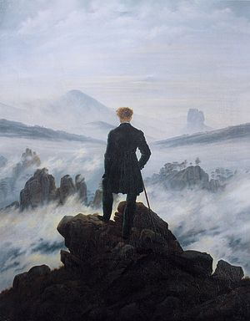
Famous Romantic Pieces
Nature never deceives us it is we who deceive ourselves.
– Jean-Jacques Rousseau
Do not give in too much to feelings. A overly sensitive heart is an unhappy possession on this shaky earth.
- Johann Wolfgang von Goethe
Two things awe me most, the starry sky above me and the moral law within me. - Immanuel Kant
Caspar David Friedrich, Wanderer Above the Sea of Fog, 1818

