Slide 1
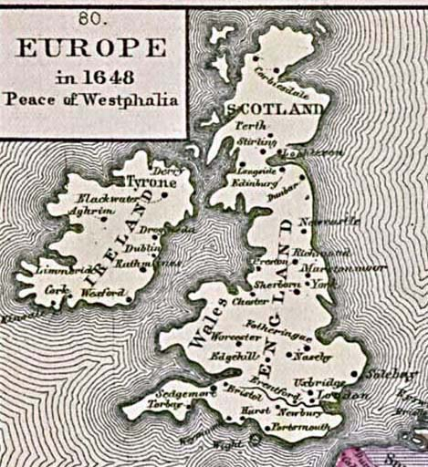
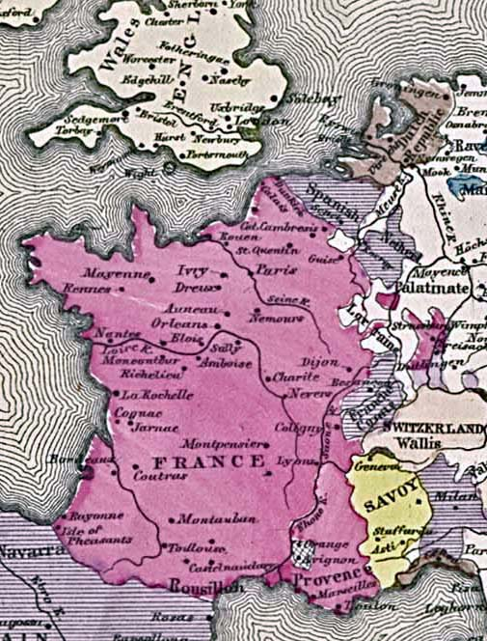
17TH CENTURY BRITAIN AND FRANCE
1 Becomes an absolute monarchy, the other a constitutional monarchy during the century
Which becomes which?

Slide 2
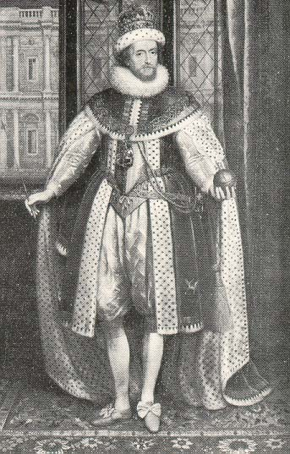
JAMES VI/I
New King on Elizabeth’s death, 1603; 1st of the Stuarts;
Proponent of Divine Right of Kings , Trew Law of Free Monarchy.
Major claim to fame – King James bible

Slide 3
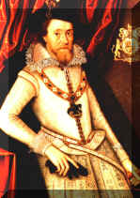
JAMES I (of England)
Stubborn, Episcopal (why would that be?!)
During his reign Puritans & Pilgrims split for New World

Slide 4
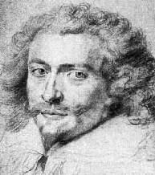
BUCKINGHAM
Court scandal doesn’t help James’ cause

Slide 5
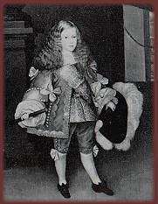
CHARLES I
Poor people skills as an adult cost him support
Ship taxes and enforcement of other “blue laws” made him unpopular

Slide 6
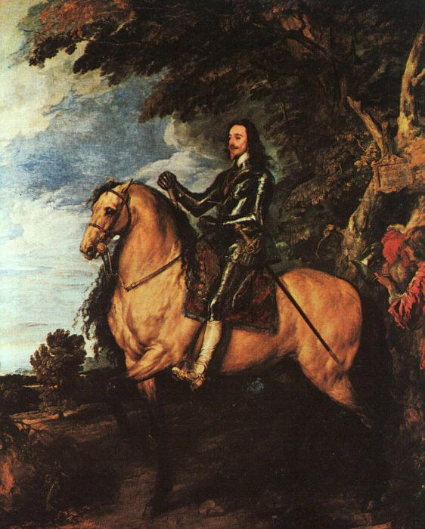
CHARLES I
Worse than dad; accused of “popery”
(define this!)
1628 presented w/ Petition of Right by Parliament; (some basic rights you should know)
Portrait by Anthony Van Dyke

Slide 7
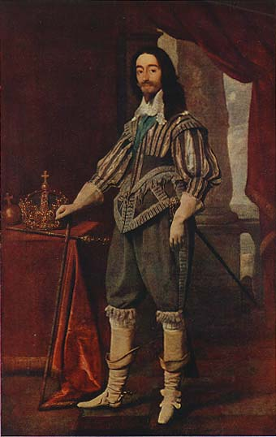
CHARLES I
Civil War in GB 1642-46; Charles’ Cavaliers vs. Parliamentary Roundheads
1649 Parliament executes Charles

Slide 8
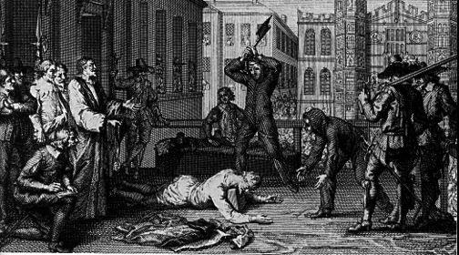
CHARLES I GETS THE AXE

Slide 9
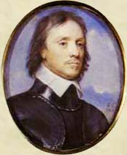
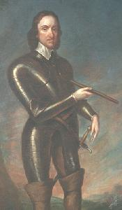
Oliver Cromwell
Created Puritan Republic, after 1653 ruled as “Lord Protector,” a military dictatorship

Slide 10
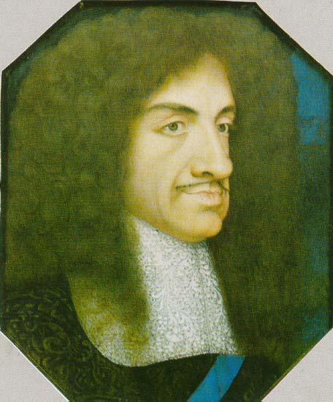
CHARLES II, THE MERRY MONARCH
Cromwell’s rule so strict & unpopular that Parliament invites the son of the man they executed to be king!
Monarchy restored;
Closet Catholic; secret deal with Louis XIV to convert

Slide 11
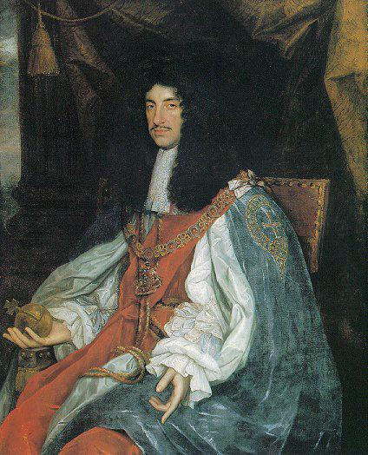
CHARLES II
Parliament passes Test Act aimed at King’s bro James;
All must swear oath against transubstantiation

Slide 12
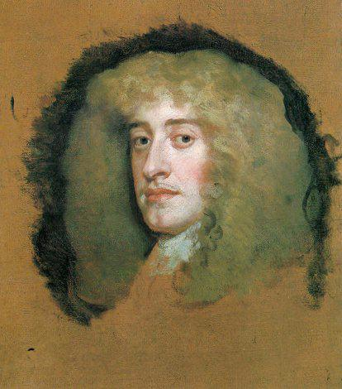
JAMES II
Crowned 1685, wants Test Act repeal;
2nd wife give birth to male Catholic heir; new danger of popery.

Slide 13
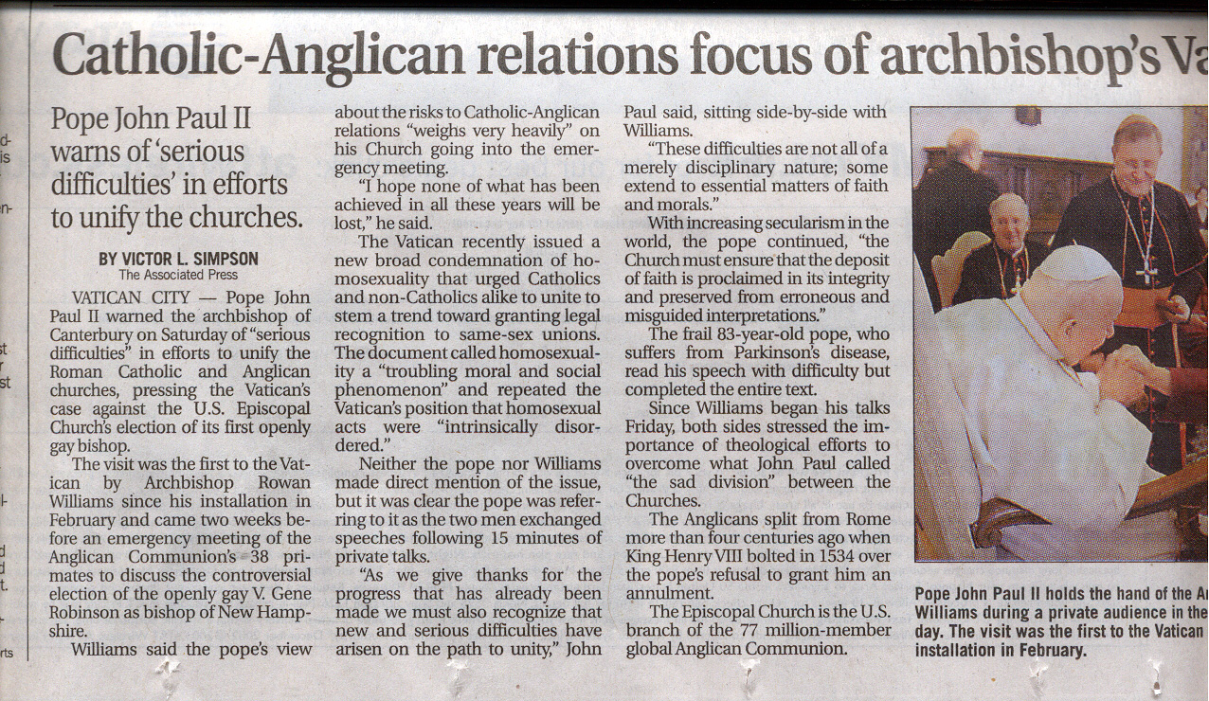
October 5, 2003

Slide 14
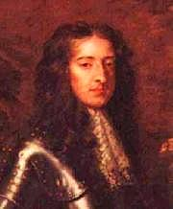
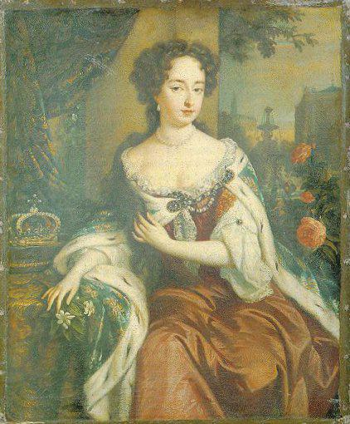
WILLIAM AND MARY
Parliament proclaims William and Mary new monarchs; GLORIOUS REVOLUTION!! Agree to Bill of Rights with guarantee of basic rights

Slide 15
John Locke’s 2nd Treatise of Government justifies Glorious Revolution & change in leadership if a monarch violated the rights of the people

Slide 16
Queen Anne – last Stuart Monarch
Daughter of James II (guess what religion?)
1701 Act of Settlement: w/out surviving children, English monarchy goes to German House of Hanover. . . because????

Slide 17
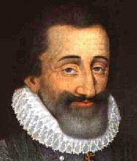
HENRY IV
FRANCE IN THE 17TH CENTURY
1ST BOURBON; POLITIQUE + EDICT OF NANTES
Assassinated 1610

Slide 18
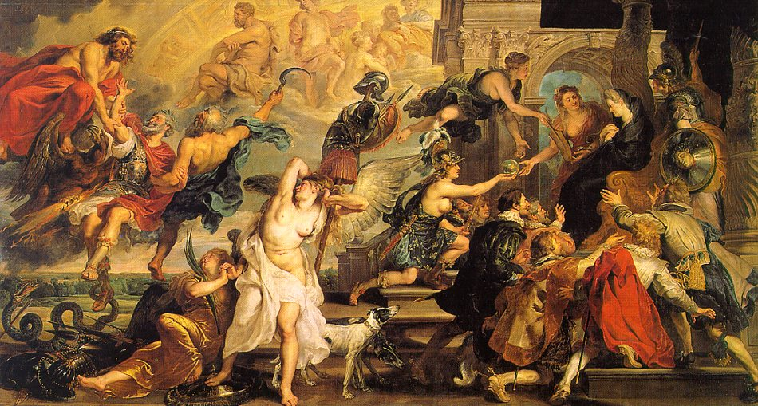
APOTHEOSIS OF HENRY IV AND THE . . .
That’s Henry on the left being dragged to heaven after his assassination

Slide 19
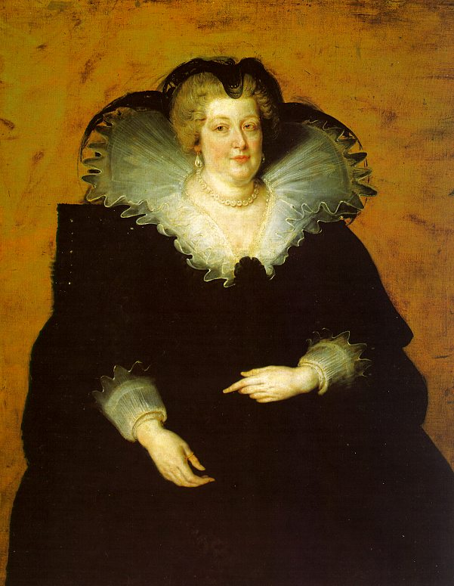
Marie d’Medici
HENRY’S WIDOW – GIVES POWER TO RICHELIEU
ESTATES GENERAL DISMISSED

Slide 20
MARIE’S CORONATION

Slide 21
EDUCATION OF LOUIS XIII

Slide 22
MARIE LANDS IN MARSEILLES

Slide 23
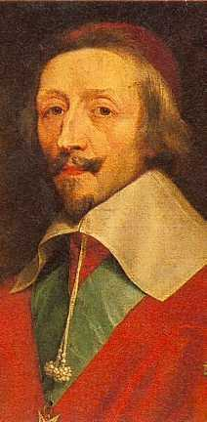
CARDINAL RICHELIEU
SECRET TO FRENCH SUCCESS IN 1ST ½ OF 17TH C
PURSUED CENTRALIZING POLICIES; BEGAN CAMPAIGN AGAINST HUGUENOTS
Wasn’t he in the Three Musketeers?

Slide 24
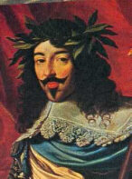
LOUIS XIII
REIGN DOMINATED BY RICHELIEU, HIS CHIEF ADVISOR
DEAD IN 1643
Not a great leader, but what about that hairstyle???

Slide 25
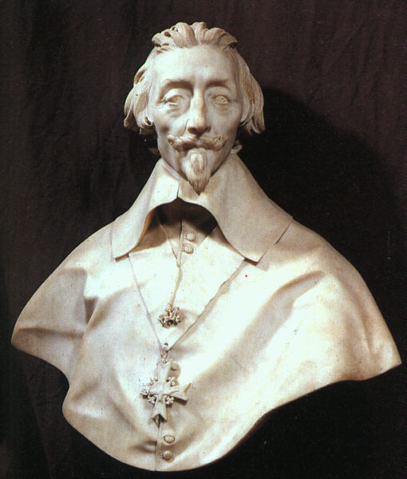
Richelieu by Bernini
Classic politique in foreign policy; during 30 years war he is more concerned with power politics than religion; supported Lutheran Gustavus Adolphus against the Catholic Hapsburgs to the advantage of France

Slide 26
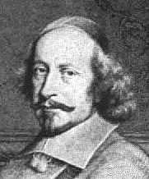
CARDINAL MAZARIN
LOUIS XIV ONLY 5; MAZARIN PUT IN CHARGE

Slide 27
LOUIS XIV AT 10
1649 – FRONDE (REBELLION) BREAKS OUT IN PARIS; NOBLES AND TOWNSPEOPLE VS. CROWN;
LOUIS WILL ALWAYS DETEST “KINGS OF STRAW”

Slide 28
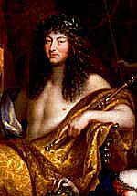
LOUIS XIV AS APOLLO, THE SUN KING
“L’ETAT C’EST MOI”
Great use of propaganda to create a positive image for his people

Slide 29
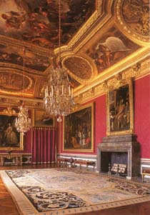
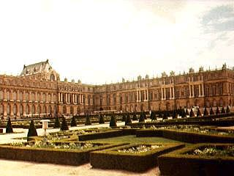
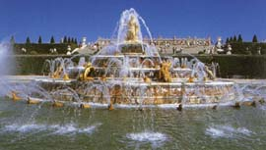
VERSAILLES
CREATED TO GLORIFY LOUIS XIV; CONSUMED OVER ½ ANNUAL REVENUES

Slide 30
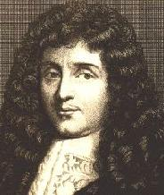
COLBERT
LOUIS’ MOST IMPORTANT MINISTER; MERCANTILISM --CLOSE GOVERNMENT CONTROL OF ECONOMY

Slide 31
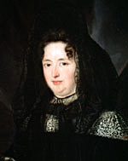
MADAME DE MAINTENON
Louis XIV’s main squeeze

Slide 32
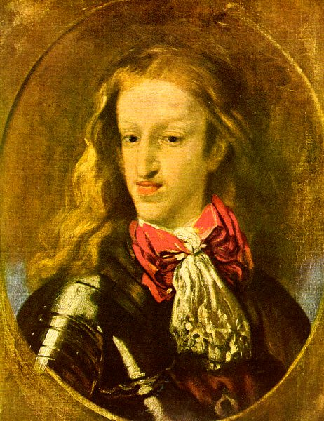
CHARLES II OF SPAIN, “THE SUFFERER”
DEATH IN 1700 LEADS TO WARS OVER SPANISH SUCCESSION;
INHERITANCE & SPANISH CROWN LEFT TO LOUIS XIV’S GRANDSON

Slide 33
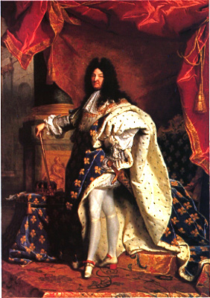
DEATH IN 1715 LEAVES MIXED LEGACY; FRANCE BROKE BUT STILL POWERFUL
On his deathbed he warns his heir against his love of war and building
How would YOU evaluate his reign???

Slide 34
Bishop Bossuet-French preacher, tutor to King Louis XIV son
“One must then, obey princes as if they were justice itself, without which there is neither order nor justice in affairs”

Slide 35
King Louis XIV
“Every time I appoint someone to a vacant position, I make a hundred happy and one ungrateful”

Slide 36
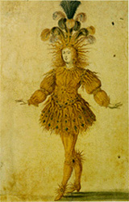
The Sun King, French painter

Slide 37
Jean Baptiste Colbert, King Louis finance minister
“It is simply, and solely, the abundance of money within a state [which] makes the difference in its grandeur and power.”

