Slide 1
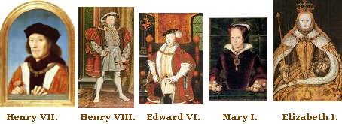
English Renaissance History
The Tudor (and Stuart) Monarchs

Slide 2
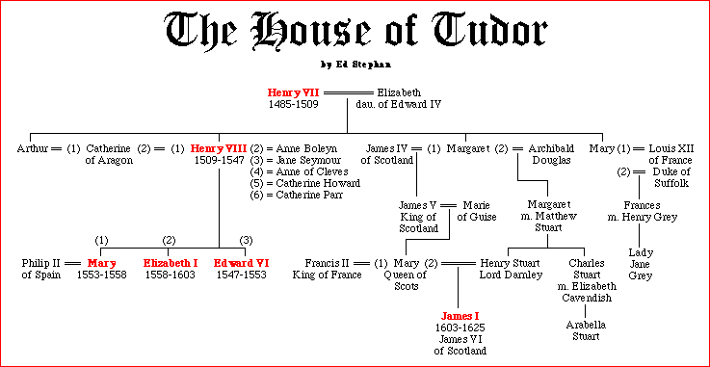

Slide 4
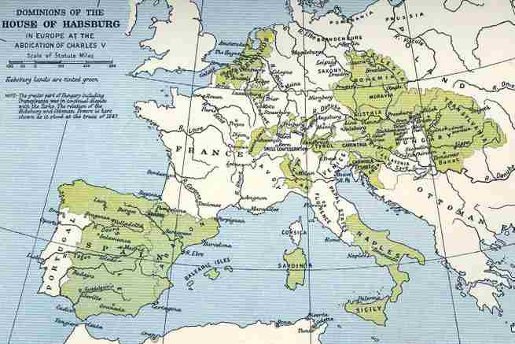

Slide 5
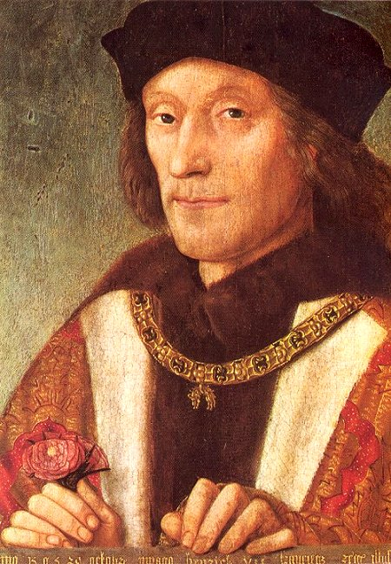
Henry VII
Henry Tudor married Elizabeth of York (daughter of Edward IV).
Henry had defeated Richard III at the Battle of Bosworth Field, ending the Wars of the Roses.
Henry VII went on to forge international relationships through the marriages of his children.

Slide 6
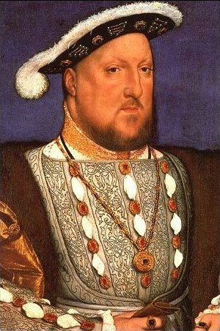
Henry VIII
Second son of Henry VII
After his elder brother Arthur died, Henry became heir to the throne.
Spain and England wanted to keep their alliance, even w/ Arthur’s death
So Henry married Catherine of Aragon, Arthur’s widow - no papal dispensation was given, and the marriage was even done by proxy; Henry was only permitted to consent at canonical age (which he never did)
Later he tried to annul this marriage so he could marry Anne Boleyn.
Henry claimed that God punished him by denying him a legitimate male heir – in Leviticus, God does threaten childlessness if a man marries his brother’s widow…so Henry came to see this marriage as cursed…

Slide 7
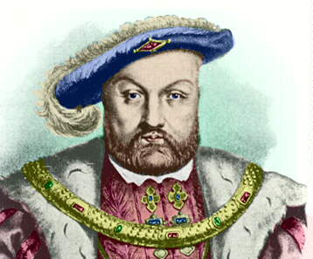
I spy an attractive lady – in-waiting called Anne Boleyn. If only I could marry her instead. Will the Pope give me a divorce?
I need a son. I have been married for 20 years and my wife, Catherine of Aragon is too old to have any more children. Who will inherit my throne when I die?
The Church is very rich. I need money for my luxurious court. If only I could get my hands on it.
The new Protestant ideas are spreading in Germany. Princes there are reforming their churches and throwing out the Catholic Church.
The Church takes money out my country in taxes to help build St Peter’s in Rome. What do I get in return?
Some people in England like the new Protestant ideas. They believe that the Bible should be in English not Latin.

Slide 8
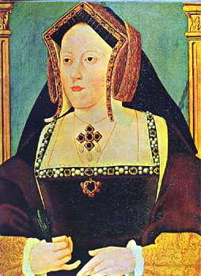
Catharine of Aragon
Catharine was the daughter of Isabella and Ferdinand of Spain.
She was married to Arthur, Henry VII’s heir, but he died, apparently before the marriage was consummated.
Later she married Henry VIII, but they only had one living child, Mary. (They had a son who died in infancy).
Henry wanted to find a husband for Mary, so that she would be unchallenged as his heiress (women were not banned from the throne, but it was untraditional).
Some suitors worried that Mary could not be a legitimate queen as Henry had married his brother’s widow…
All of these issues reached the boiling point after 20 yrs. b/c of constant succession worries, Catharine’s diminishing looks, and the appearance of Anne Boleyn…
Catharine’s later years were ones of persecution where Henry tried to make her sign annulment papers.

Slide 9
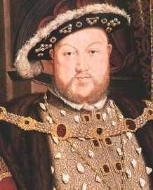
Henry VIII (cont.)
When he wanted to marry Anne Boleyn, Henry created the Church of England and banned the Catholic Church from his nation. He also seized all of the property of the Catholic Church, thereby increasing the wealth of England.

Slide 10
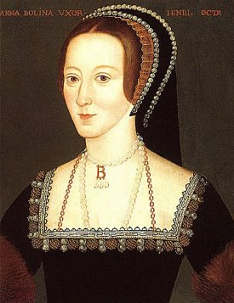
Anne Boleyn
Anne became Henry VIII’s second wife. But since his first, Catharine of Aragon, was still living, many Catholics, felt that her child Elizabeth was illegitimate.
When she failed to produce a male heir, there were rumours that she was infertile…and by that time Henry had met Jane Seymour.
Anne tried to woo Henry back, but he had her charged with adultery and incest and beheaded…

Slide 11
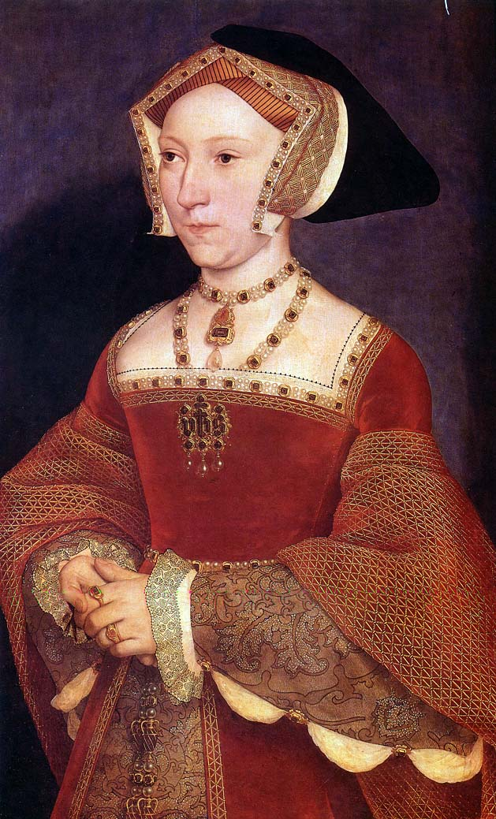
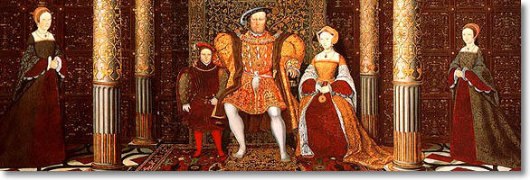
Elizabeth and Mary were raised together
Queen Jane Seymour showed favour to Mary but treated Elizabeth well
And the Queen did finally have that male heir, Edward VI; this ended the sisters’ succession argument
When Jane Seymour died (a fever), the 3 siblings were raised together

Slide 12
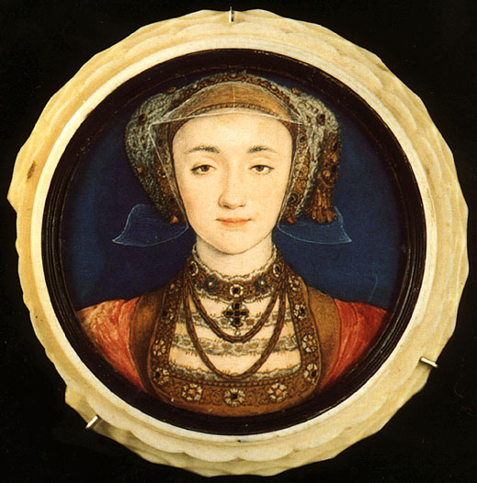
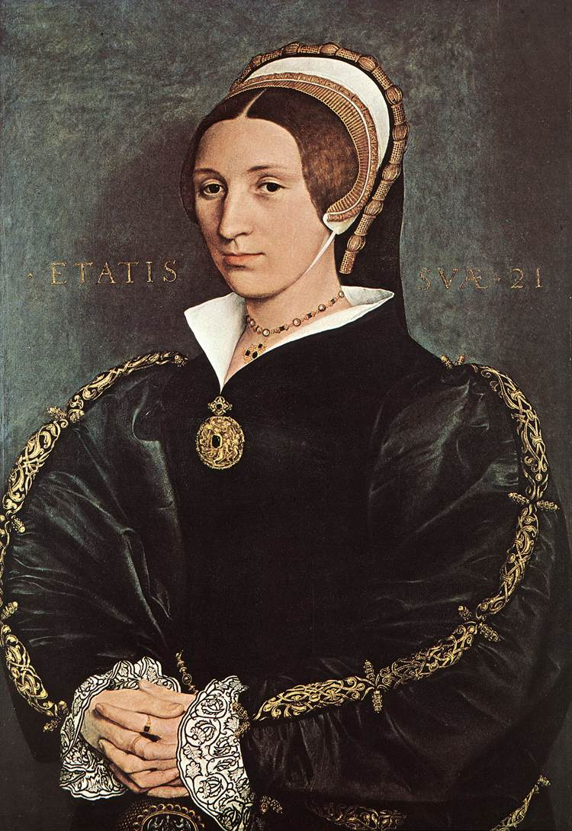
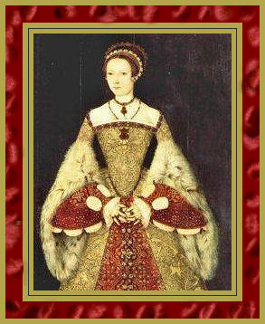
Henry VIII went on to marry Anne of Cleves – it only lasted 6 months, and Henry got out of it by saying he was impotent on the wedding night…
Henry then married Catherine Howard, a 17 year old, who was soon beheaded for adultery
So Henry married for the final time, to Catherine Parr – she got along well with all the children
Elizabeth stayed the 3rd lady of the court – only the Habsburgs still called the “whore’s daughter”

Slide 13
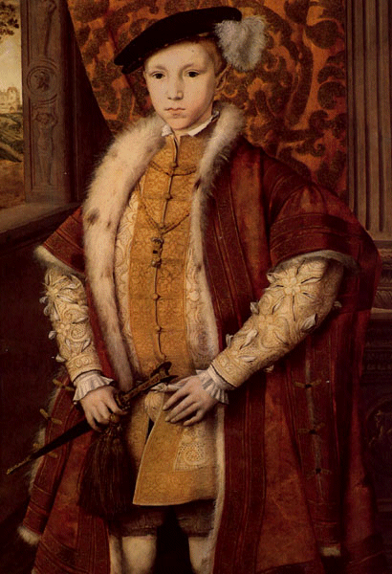
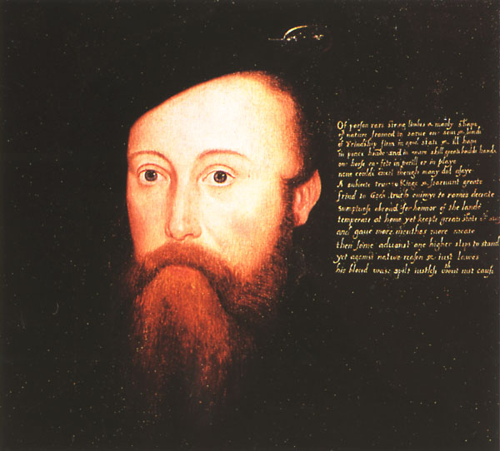
Edward VI
He was the son of Henry VIII and Jane Seymour - a Protestant who became king at the age of 9.
The Church of England expanded while he was king.
But he was sickly and died at the age of 16.
During his kingship, England was largely under the rule of Edward’s council, which included Thomas Seymour (the Duke of Somerset)…

Slide 14
Elizabeth fell in love with Thomas Seymour, and he wanted to marry either Elizabeth or Mary (but they could only marry w/ the permission of the entire council), so Seymour instead married Catherine Parr (Henry’s widow) – as Elizabeth lived w/ Parr, this made Seymour her stepfather and guardian (and it is likely that he abused her during this time)
When Parr died in childbirth, she had left all to Seymour in an oral will

Slide 15
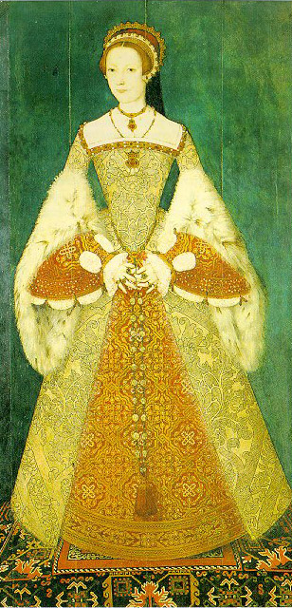
Jane Grey
In need of a lady of the household, he brought in Lady Jane Grey (Henry VIII’s grand-niece), saying he would marry her off to Edward VI
Seymour wanted Lady Jane Grey as the next queen, as opposed to Edward’s sister Mary, who was Catholic. (Seymour’s son had married Jane Grey.)
in 1549, Edward passed the Act of Uniformity, introducing the Protestant Prayer Book – Mary looked to Catholic Spain and her cousin Charles V for assistance – basically, she disobeyed her brother and father…
So all the fundamental 16th century values came into conflict – religion, patriotism, the law, dynastic succession…

Slide 16
Edward opted for religion and plotted to get rid of Mary (and Elizabeth, as he thought she would not go along w/ him)
Edward thought succession would go to the male descendants of Mary Tudor (Henry VIII’s sister)
There were no male heirs at that time, but it was assumed someone would have a son eventually…but then Edward’s health went into rapid decline, and time was running out
On his deathbed, Edward changed his will to indicate that Lady Jane Grey (and not her male heirs) should succeed him
When Edward died, Jane became the queen, but Mary also proclaimed herself the queen – when Jane’s army faltered, the council abandoned her
When Mary recaptured the throne she had Seymour and Jane executed (Jane was queen for 9 days)...

Slide 17
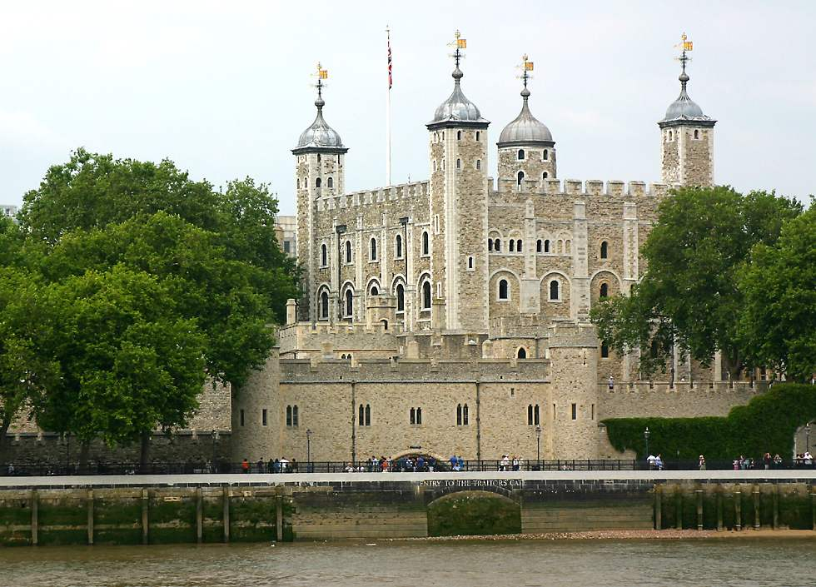

Slide 18
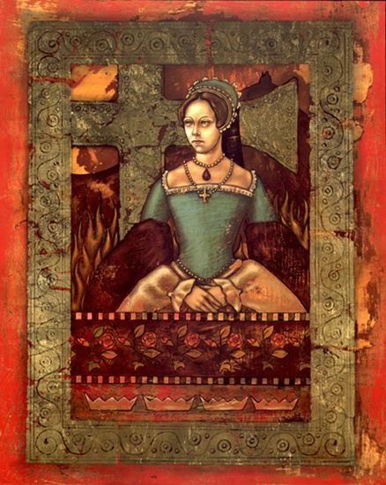
Mary I (Bloody Mary)
Mary was the daughter of Henry VIII and Catharine of Aragon.
During her childhood, Mary was persecuted by Henry when he wanted to annul his marriage to her mother.
As Queen she attempted to restore Catholicism, and she married the young Philip from Spain.
She also had more than 300 Protestants killed.
None of these actions was popular with the now firmly entrenched Protestant England

Slide 19
Mary pressured Elizabeth to convert to Catholicism – she learned to go thru the motions
Mary turned against Eliz. anyway – saw her as a threat
She wanted a husband to play the necessary chivalric role; at this time Charles V offered his handsome 26 yr old son Philip (she was 37 and less attractive)
Spain was looking for an alliance w/ Eng. against France and hoped a re-Catholicized Eng. would help Spain against the revolt in the Netherlands
Many in Eng. never accepted her marriage to Philip = xenophobia!
A rebellion erupted against Mary (=Wyatt’s rebellion) – Eliz. was connected to it, and ended up in the Tower…
But she admitted nothing and was spared, finding herself instead under house arrest

Slide 20
But Mary and Philip had trouble conceiving a child…Philip decided to leave and pursue other kingdoms instead…and he came to favour Elizabeth over Mary as he thought it was better for the Habsburgs (w/o Eliz., the other successor was Mary, Queen of Scots, who would have allied with France)
Philip had managed to take Eng. into a war w/ Fr., and the Eng. lost the fortress of Calais…
Mary’s regime had failed, and was unpopular anyway with the 100s of burnings…
When Mary died peacefully, Elizabeth acceded to the throne peacefully – she was proclaimed in only 6 hrs. as having the “lawful right and title to the crown”

Slide 21
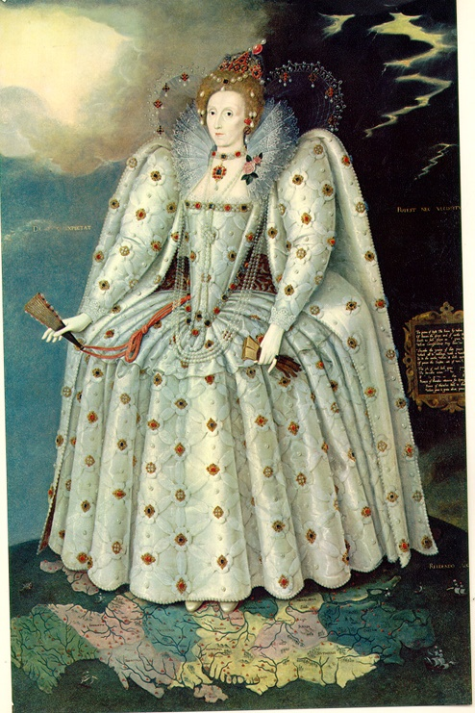
Elizabeth I
The red-haired daughter of Henry VIII and Anne Boleyn, she became England’s greatest leader. She kept control of England by refusing to marry anyone and playing one noble against another – many hoping to marry the Queen. She kept religious wars down, advanced exploration, became a patron of the arts, and brought England to the position of world power with the defeat of the Spanish Armada

Slide 22
Elizabeth worked hard to avoid religious conflict – when the House of Lords blocked some of her religious bills, she prorogued Parliament and went to the Chapel Royale, where a wooden table had replaced the stone altar and mass was in English (not Latin)
She also organized public debates on religion, where the Protestants were given every advantage
And in future H. of L. votes, she made sure certain Lords were “absent”
w/ that, the Church of England was again entrenched → oaths were required, and any non-compliant bishops were dismissed – but she kept the punishments for “heresy” light…Catholics went into hiding, but she largely turned a blind eye as long as public demonstrations didn’t occur
She also kept a certain degree of church ceremony; as a monarch, she saw the advantage of ritual

Slide 23
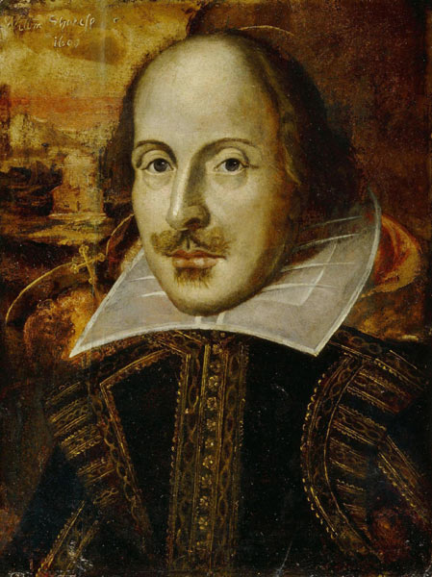
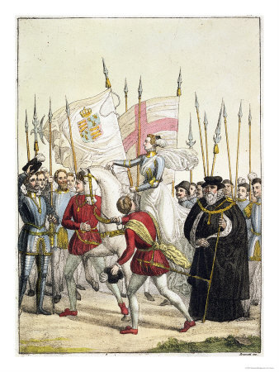
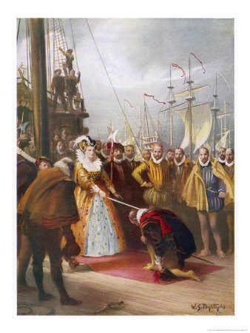
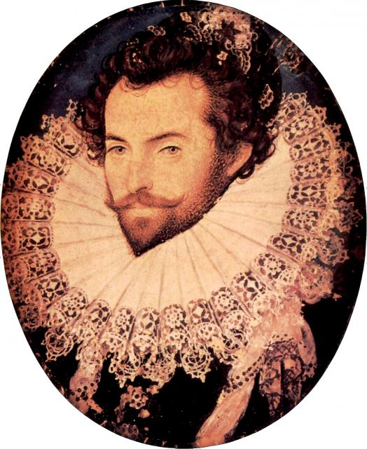

Slide 24
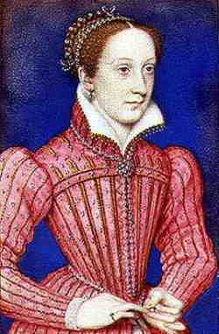
Mary (Stuart), Queen of Scots
Mary was the daughter of James V and destined to be the Queen of France.
When Francois II died, she came back to be Queen of Scotland.
English Catholics believed that she was the only legitimate heir after Mary I’s death – they rallied around her.
Given the threat, Mary was brought to Eng. as a “guest” (prisoner)
This again raised the succession issue…the Protestant Elizabeth had a Catholic successor…and Mary became “more” Catholic…
w/ Mary as a symbol, rebellion began in the countryside

Slide 25
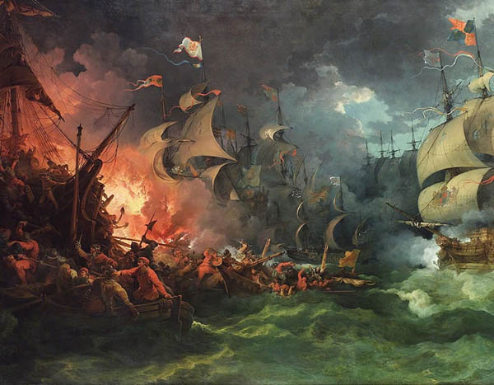
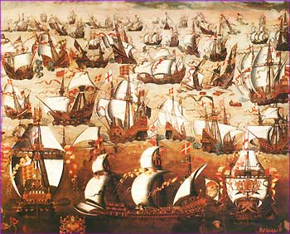
The Pope entered into things, saying Elizabeth was a heretic…so Elizabeth became a more hard-line Protestant
At this point, English Catholics turned to Spain for help (and Spain was anti-Elizabeth as she supported piracy in the New World and had aided the Dutch Revolt)
When proof of Mary’s treachery came to light, Elizabeth I had her executed…Spain attacked, but the Armada failed…

Slide 26
JAMES I
James I of England was James VI of Scotland. His mother was Mary Queen of Scots, and at Elizabeth I’s death, James was named her heir.
A Catholic, he was known for the authorization of the King James Version of the Bible, as well as for being the “Wisest Fool in Christendom”.

