Slide 1
The Wars of Religion (1560s-1648)

Slide 2
Civil War
In France
(1562-1598)

Slide 3
The Valois Family in France: The Beginning of the End
Henry II was the last powerful Valois King
Three weak sons followed:
Francis II (r.1559-1560)
Charles IX (r.1560-1574)
Henry III (r.1574-1598)
Catherine de Medici controlled her sons:
Developed a reputation for cruelty
Played both sides in the civil war (Protestant & Catholic)

Slide 4
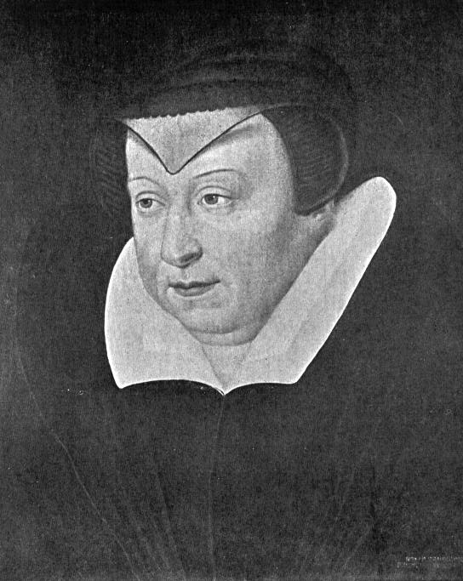
Catherine de Medici

Slide 5
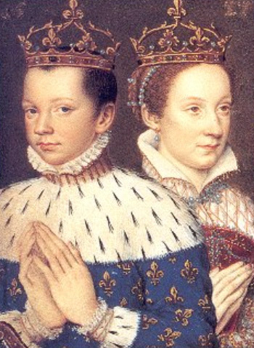
Francis II & his Wife, Mary Stuart

Slide 6
The French Civil War
There were two sides:
Guise family led Catholics in North
Bourbon family led Huguenots in South
Fighting for the royal inheritance
Catherine supported the Guises in the first phase.
St. Bartholomew’s Day Massacre
August 24, 1572
20,000 Huguenots were killed
Henri of Navarre, a Bourbon, survived

Slide 7
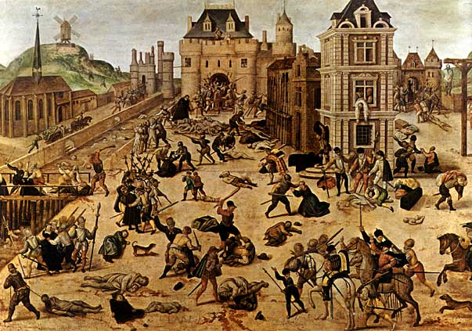
St. Bartholomew’s Day Massacre

Slide 8
The French Civil War
War of the Three Henrys (1585-1589)
King Henry III
Henry of Guise- Catholic
Henry of Navarre- Huguenot
Henry of Guise and Henry III were assassinated in 1589.
Henry of Navarre defeated Catholic League & becomes Henry IV of France.
Effects of Civil War:
France was left divided by religion
Royal power had weakened
Valois family now replaced by Bourbons

Slide 9
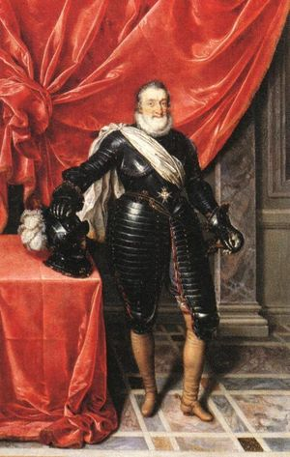
Henry IV of France
Ended Spanish interference in France
Converted to Catholicism :
Did this to compromise and make peace
This was an example of politique [the interest of the state comes first before any religious considerations]
Fighting for the royal inheritance
Passed Edict of Nantes in 1598:
Granted religious rights to Huguenots
Did not grant religious freedom for all

Slide 10
The Thirty Years’ War (1618-1648)

Slide 11
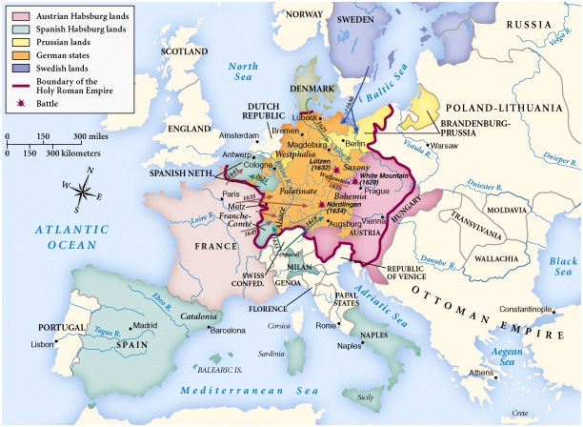
1618-1648

Slide 12
Characteristics of the Thirty Years War
The Holy Roman Empire was the battleground.
At the beginning it was the Catholics vs. the Protestants.
At the end it was Habsburg power that was threatened.
Resolved by the Treaty of Westphalia in 1648.

Slide 13
The Bohemian Phase: 1618-1622
(modern day Czech Republic & Slovakia)
Ferdinand II inherited Bohemia.
The Bohemians hated him.
Calvinists demanded more freedom from Catholic Habsburg ruler.
Ferdinand refused to tolerate Protestants.
Defenestration of Prague: May, 1618
Two of the emperor’s officials thrown out of window in Prague during negotiations

Slide 14
The Bohemian Phase: 1618-1622
Results:
Bohemia named a new king, Frederick V
Ferdinand II borrowed an army from Bavaria.
Catholic League and Spanish Habsburgs offer support
Ferdinand II becomes Holy Roman Emperor.
Frederick lost his lands in the fighting.
The rebellion in Bohemia inspired others, but Bohemia becomes Catholic by 1635.

Slide 15
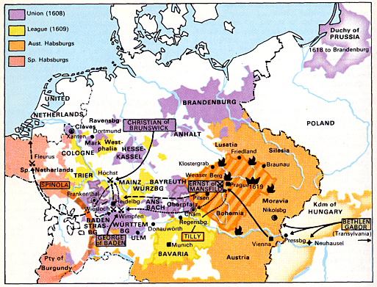
Bohemian Phase

Slide 16
The Danish Phase: 1625-1629
Ferdinand II tried to end all resistance.
Tried to crush Protestant northern Holy Roman Empire.
Ferdinand II used Albrecht von Wallenstein for the army.
King Christian IV, Protestant leader of Denmark intervenes to defend fellow Protestants in Northern Germany
Wallenstein scores major victories and defeats Protestants in north.

Slide 17
Edict of Restitution (1629):
Restored to Catholics all lands lost since 1552.
Deprived all Protestants, except Lutherans, of their religious and political rights. Calvinism is outlawed.
German princes feared Ferdinand →
he fired Wallenstein in effort to calm them.

Slide 18
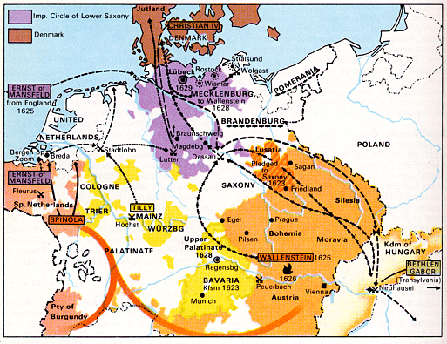
Danish Phase

Slide 19
The Swedish Phase: 1630-1635
France & Sweden now get involved.
Both want to stop Habsburg power.
Sweden led the charge.
France provided support.
Gustavus Adolphus, King of Sweden and Protestant leader, invaded the HR Empire to support fellow Protestants.
Ferdinand II brought back Wallenstein.
Adolphus dies in Battle of Luetzen (1632)
Swedish advance was stopped.

Slide 20
German princes still feared Ferdinand II.
Wallenstein assassinated to appease them.
Edict of Restitution revoked
Southern Germany remains Catholic
Cardinal Richelieu of France provides aid to Sweden as a way to destroy Habsburg power.

Slide 21
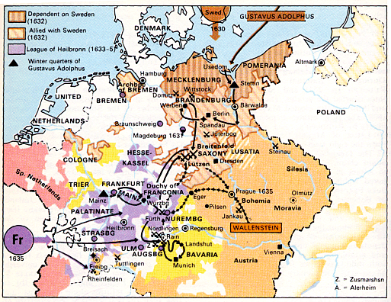
Swedish Phase

Slide 22
The French Phase: 1635-1648
All countries in Europe now participated (except England).
France & Sweden switched roles. France now led the charge, Sweden provided support.

Slide 23
The French Phase: 1635-1648
French want to destroy Habsburg power.
Religious issues become secondary to political
Coalition of Catholic France and Protestant countries (Netherlands, Switzerland, Germany) fight Catholic Habsburgs.

Slide 24
This phase was most destructive!
8 million dead → 1/3 of the population [from 21 million in 1618 to 13.5 million in 1648]
German towns decimated.
Caused massive inflation.
Trade was crippled throughout Europe.
Agriculture collapsed → famine resulted.

Slide 25
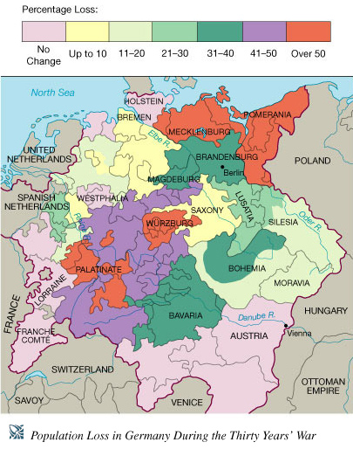
Loss of German Lives in 30 Years’ War

Slide 26
The Peace of Westphalia (1648)
Political Provisions:
Each German prince became free from any kind of control by the HR Emperor.
The United Provinces [Dutch Netherlands] became officially independent southern part remained a Spanish possession.
France received most of the German speaking province of Alsace.
Sweden got lands in Northern Germany on the Baltic & Black Sea coasts.

Slide 27
Switzerland became totally independent of the HR Emperor → Swiss Confederation.
Sweden won a voice in the Diet of the HR Empire
Brandenburg got important territory in central Germany & on the North Sea. (will later become Prussia)

Slide 28
The Peace of Westphalia (1648)
Religious Provisions:
Calvinists would have the same privileges as the Lutherans had in the Peace of Augsburg.
The ruler of each state could determine its official religion, BUT [except in the hereditary lands of the Habsburgs], he must permit freedom of private worship.

Slide 29
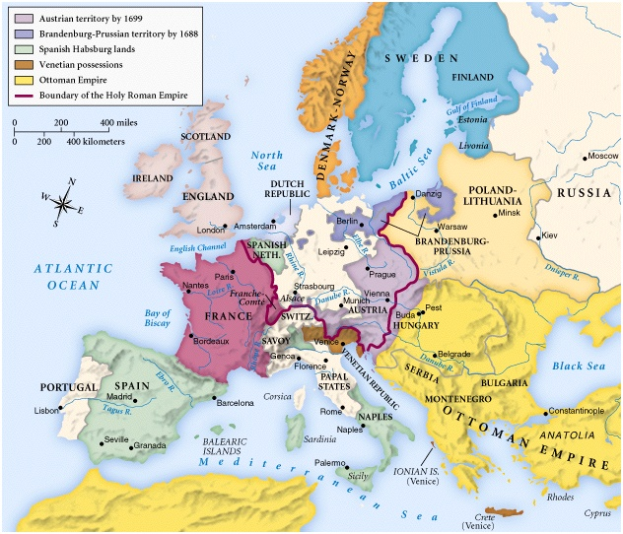
1688-1700

Slide 30
Nobody Was Happy!
Many Protestants felt betrayed.
The pope denounced it.
Only merit: it ended the fighting in a war that became intolerable!
For the next few centuries, this war was blamed for everything that went wrong in Central Europe.

